Slide 1
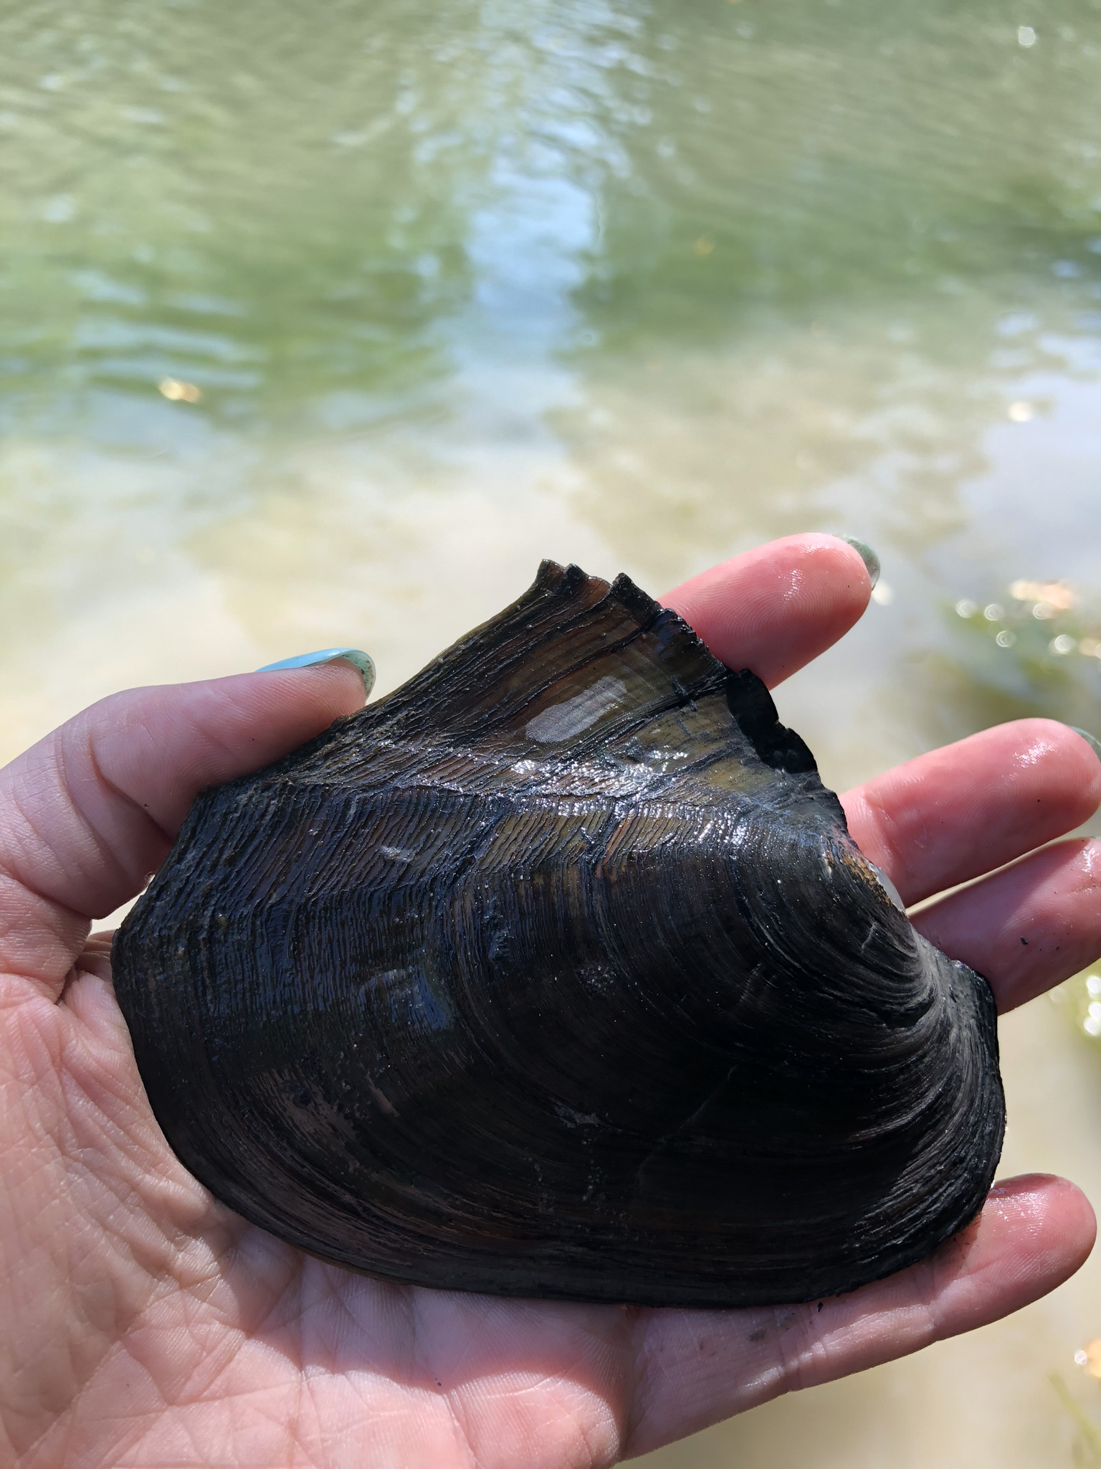
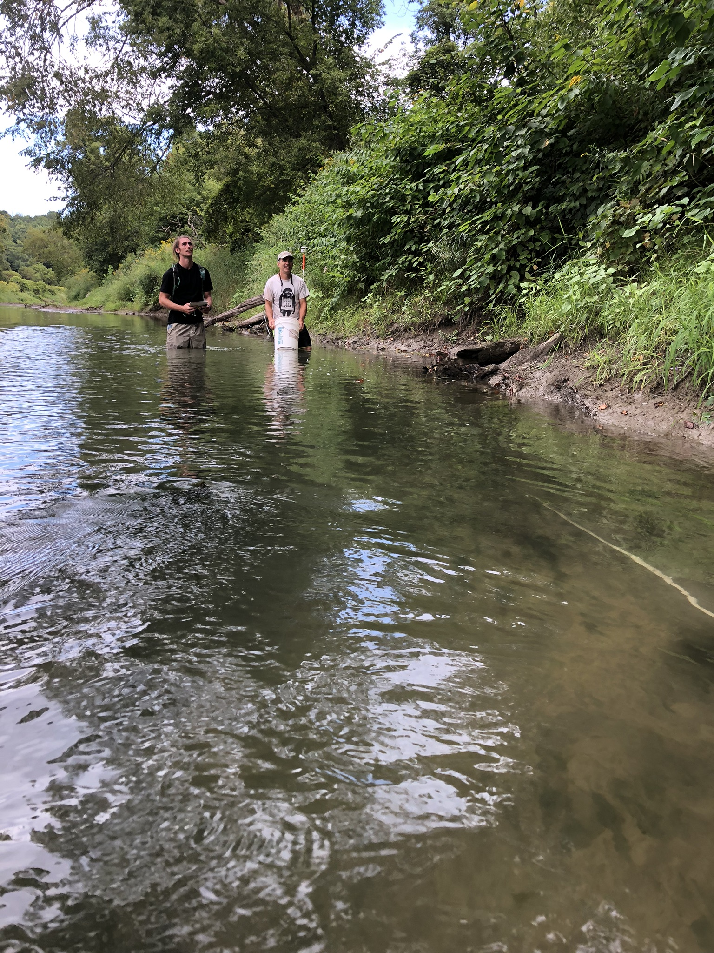
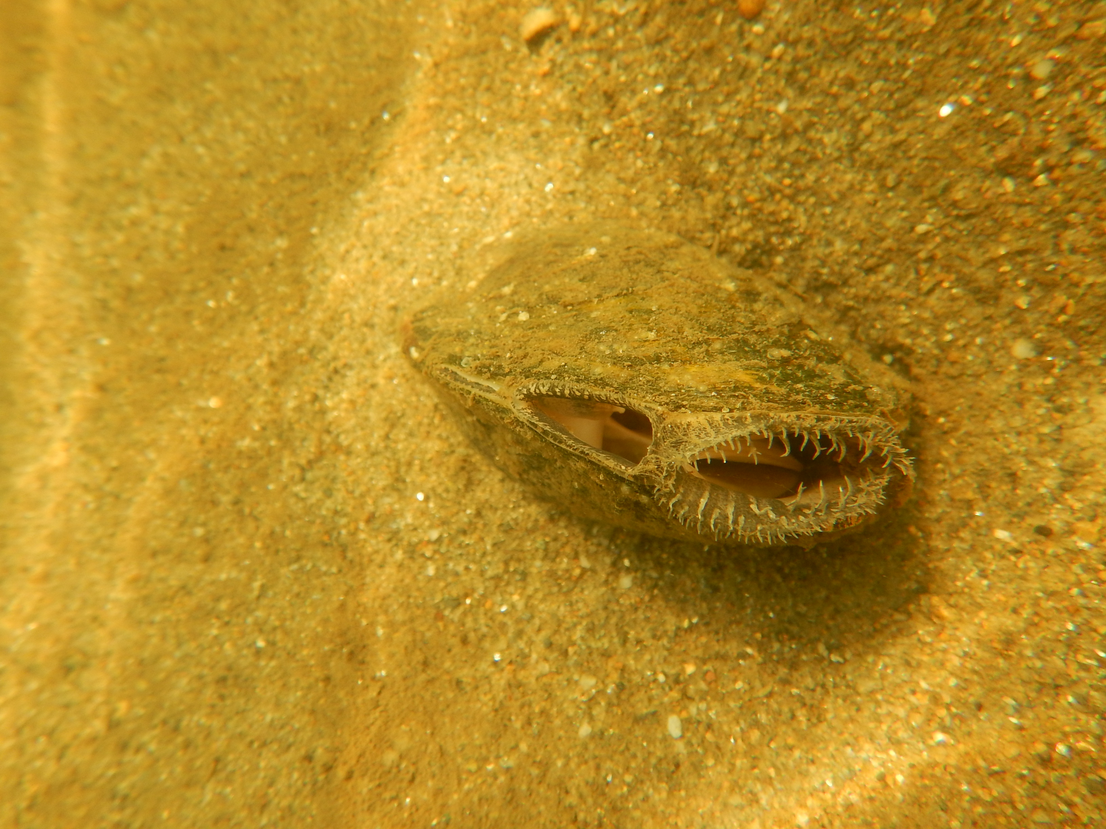
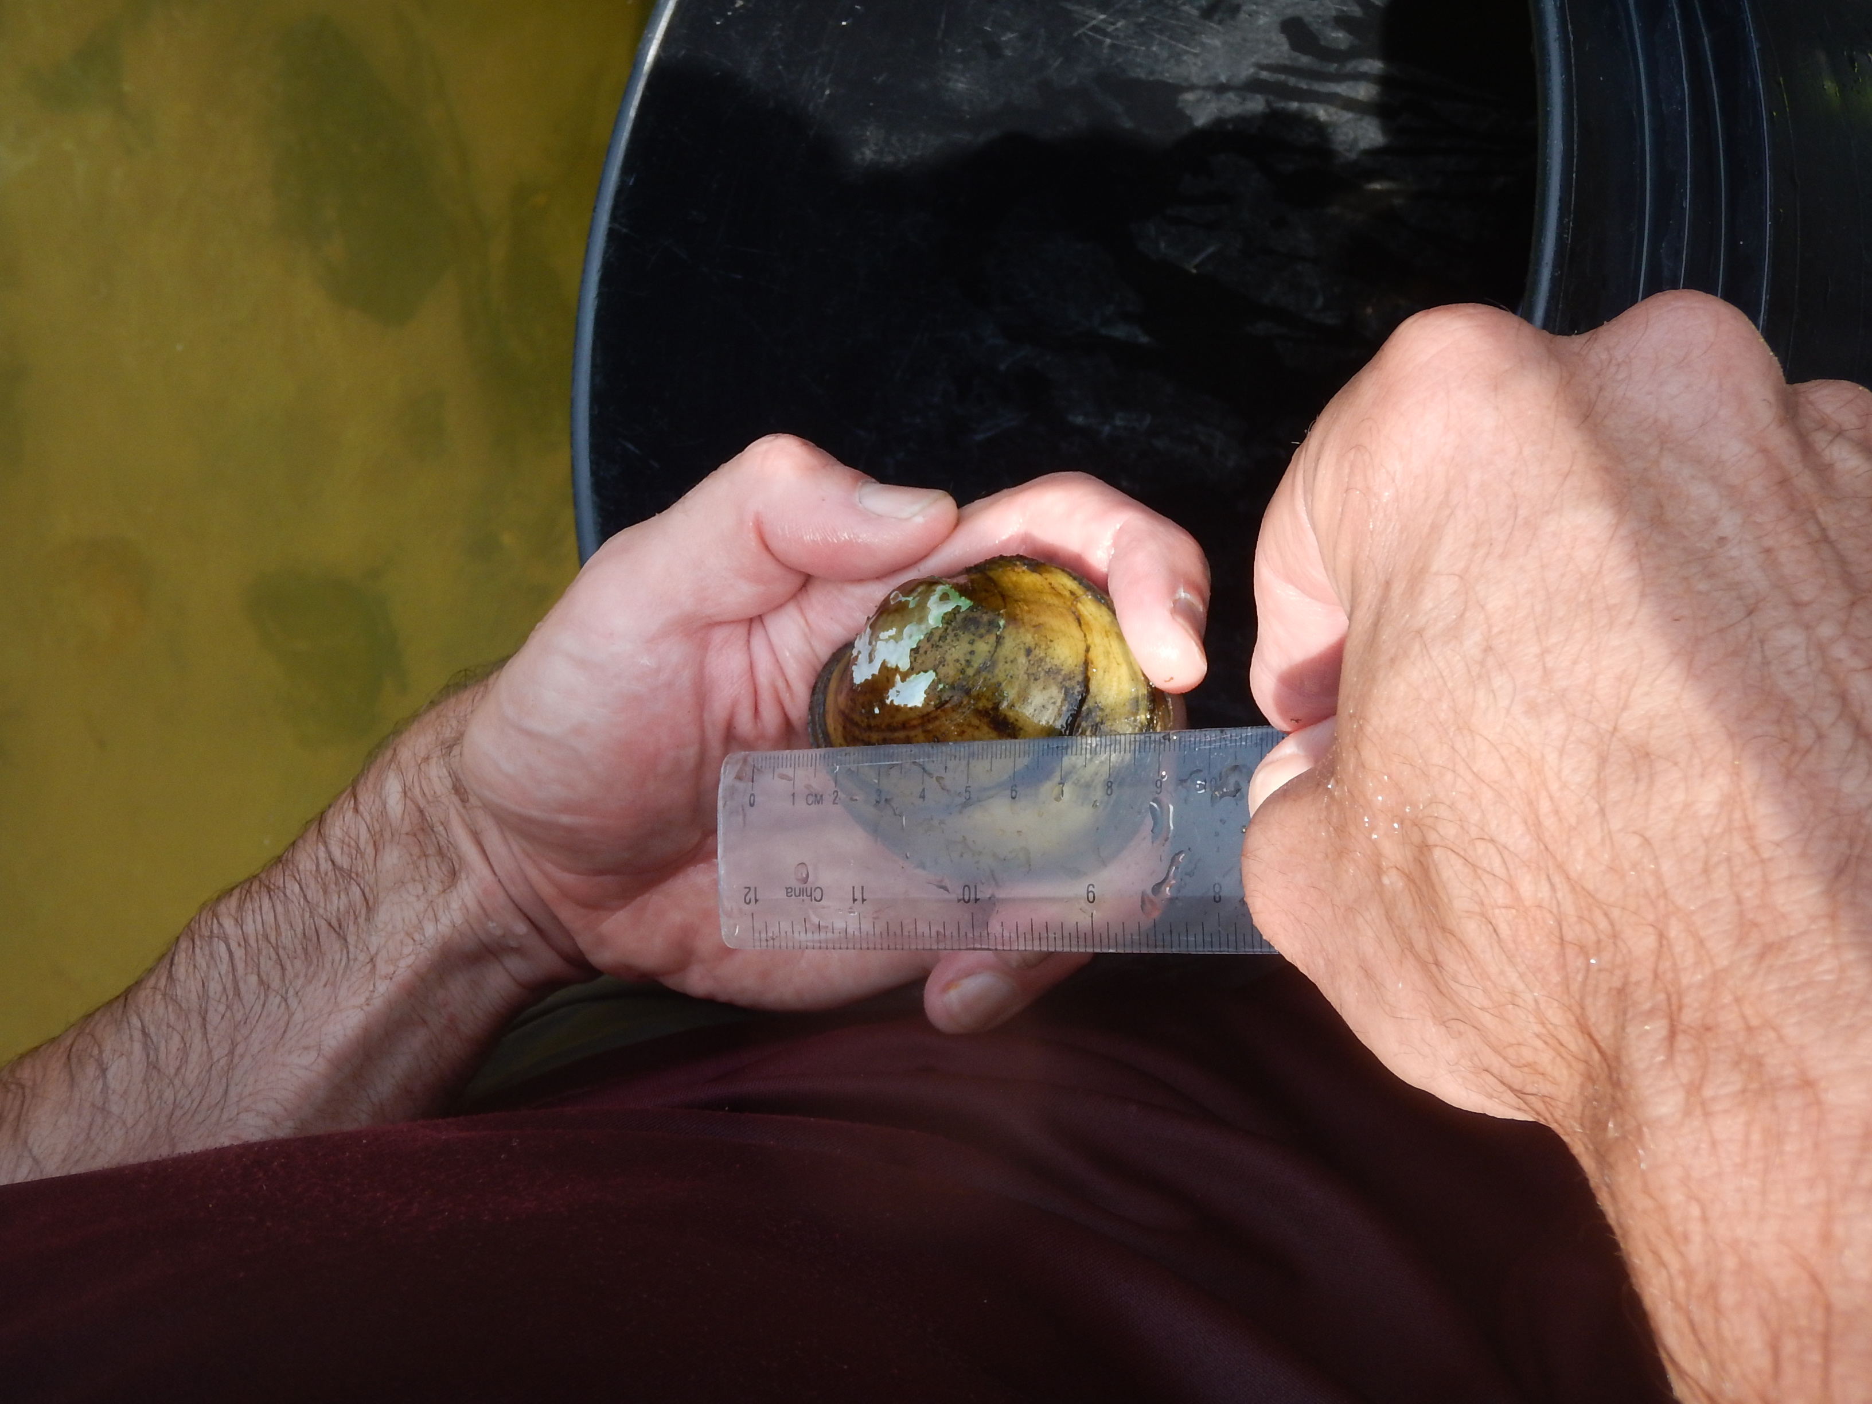
Long-term freshwater mussel population trends in the lower Poultney and Lamoille Rivers
Paul Marangelo (The Nature Conservancy - Vermont Chapter)
Michael Lew-Smith (Arrowood Environmental)
Sponsor/grantee: Lake Champlain Committee; Funding: Vermont Dept F&W

Slide 2
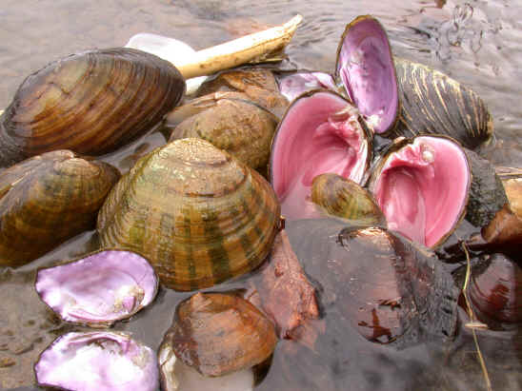
North America: Center of the world’s freshwater mussel diversity
Over 300 species
Most at-risk group of animals
20 species extinct
72% Endangered Threatened, or special concern
Chronic near-universal declines
>80 species in Mississippi/Ohio River basin
180 species in Alabama alone

Slide 3
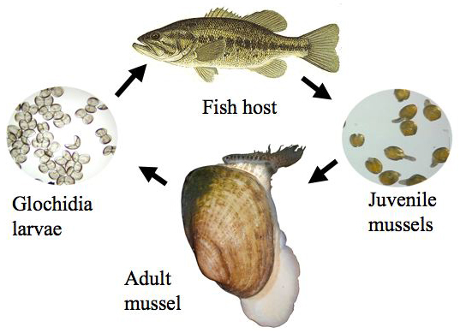
Unique life cycle
Larvae are fish parasites! adaptation for life in rivers
Some mussels use specific host fishes – depend on health of fish populations

Slide 4
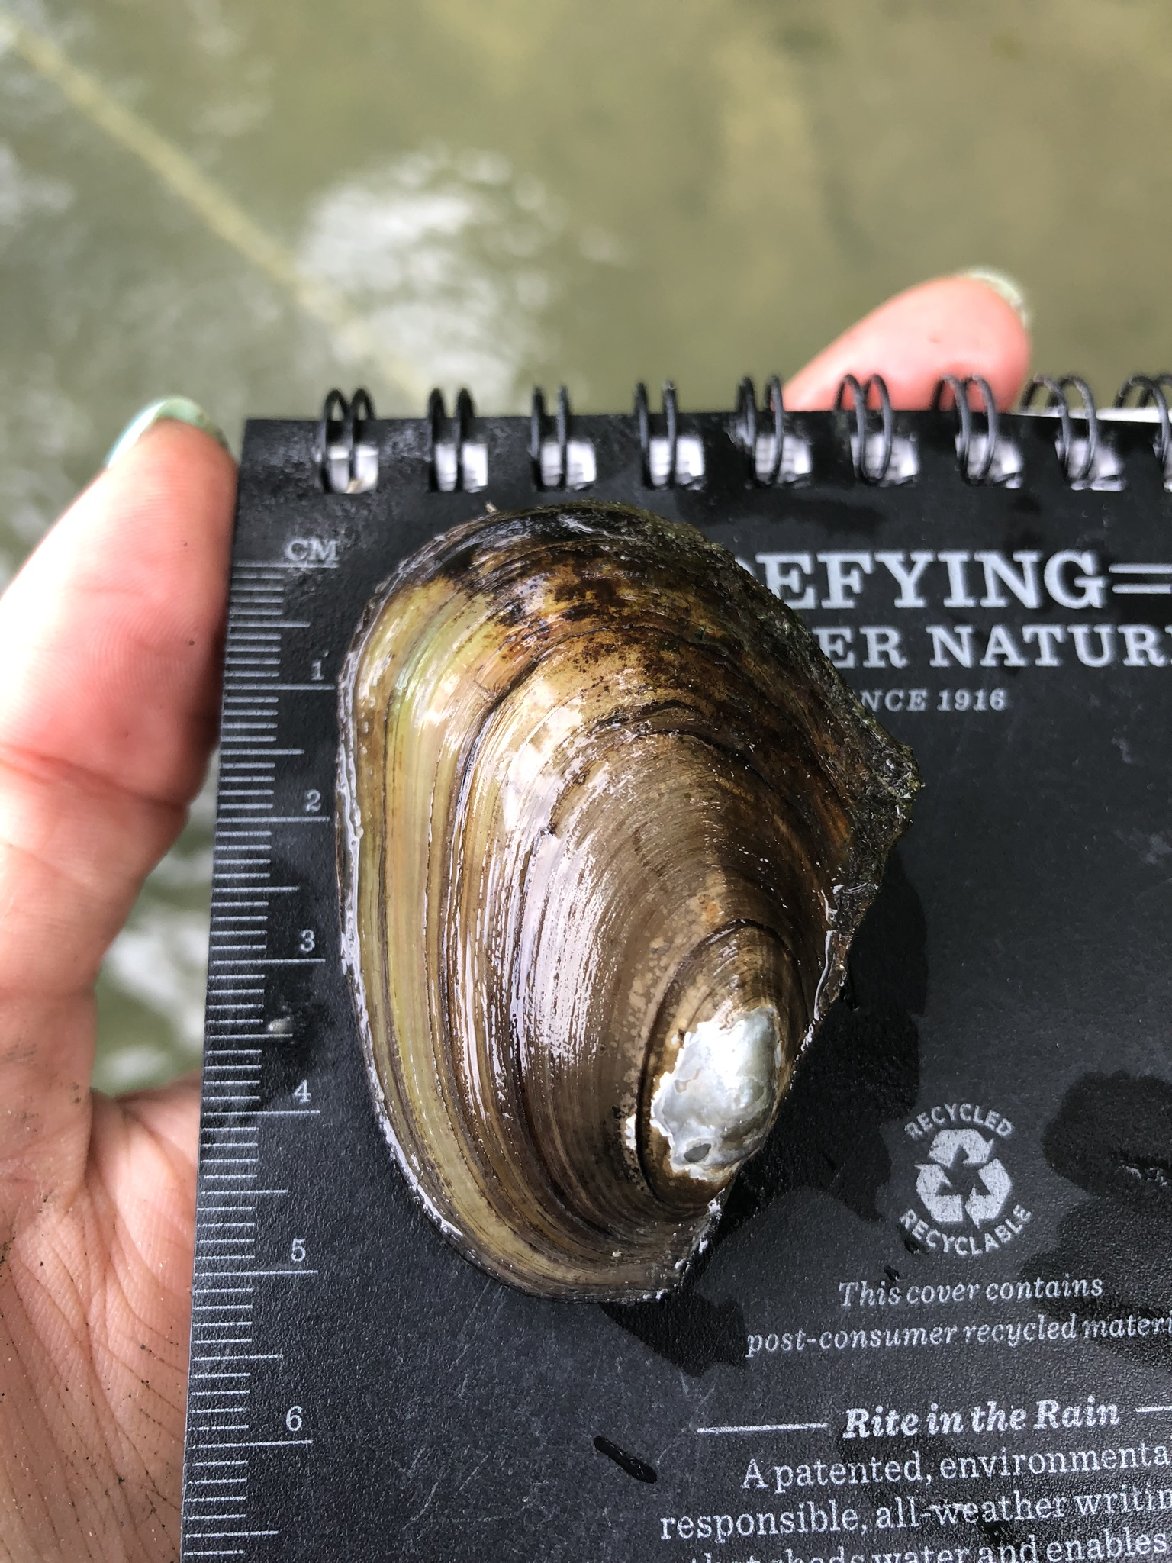
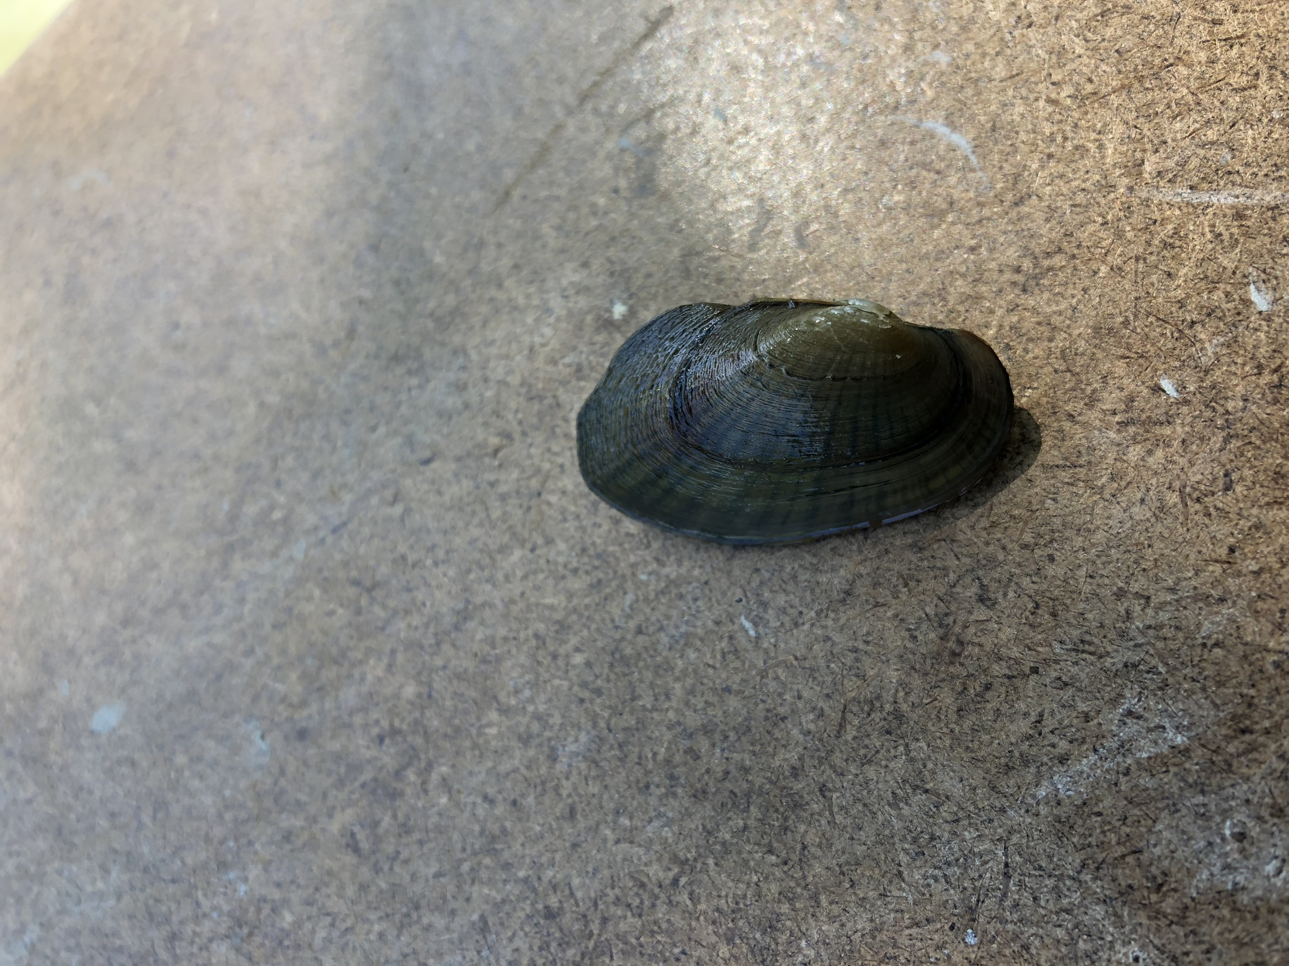
Mussels in Vermont
19 species
10 state listed, one federally endangered
Most diverse mussel assemblage in New England
Lake Champlain drainages are species rich: connection to Great Lakes/interior basin during glaciation
Greatest diversity found in lower segments (<12 miles) of Lake Champlain Tributaries

Slide 5
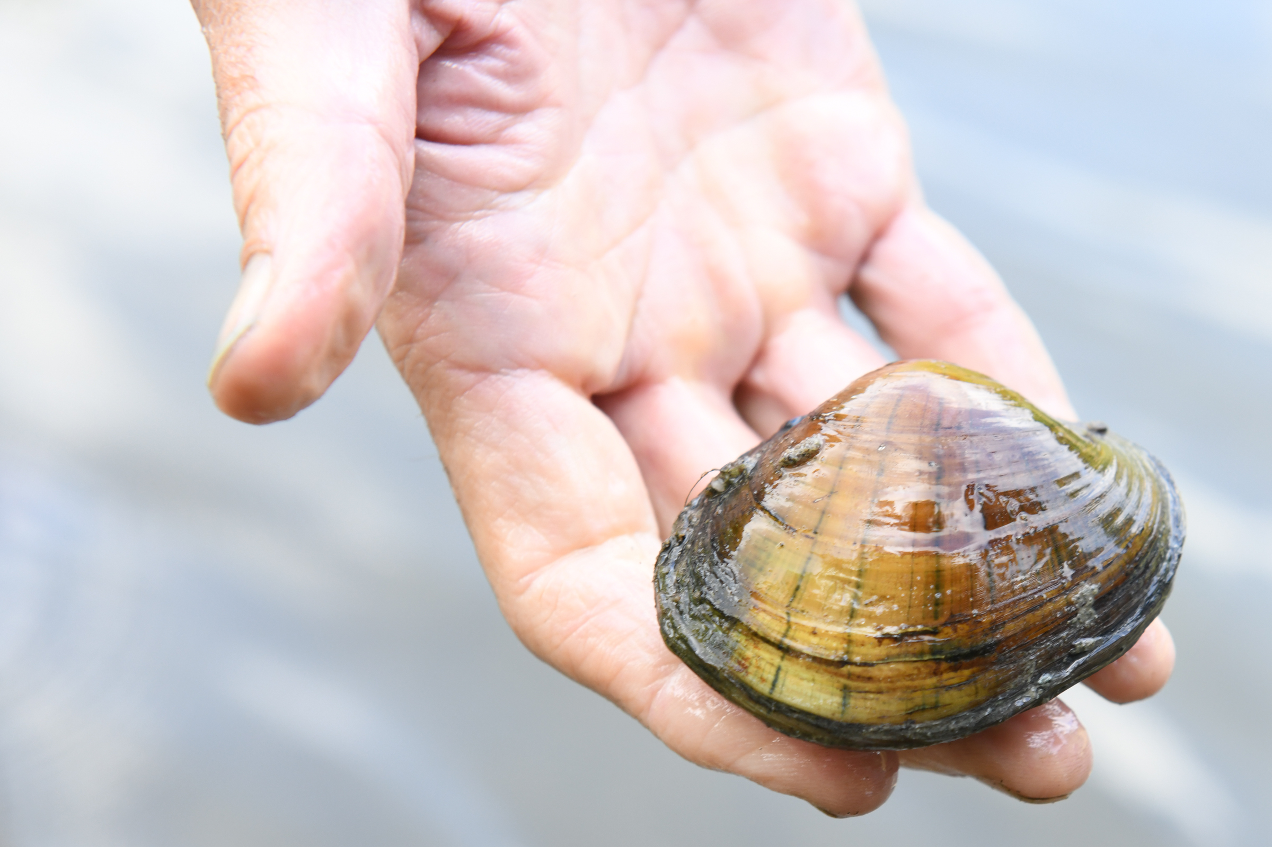
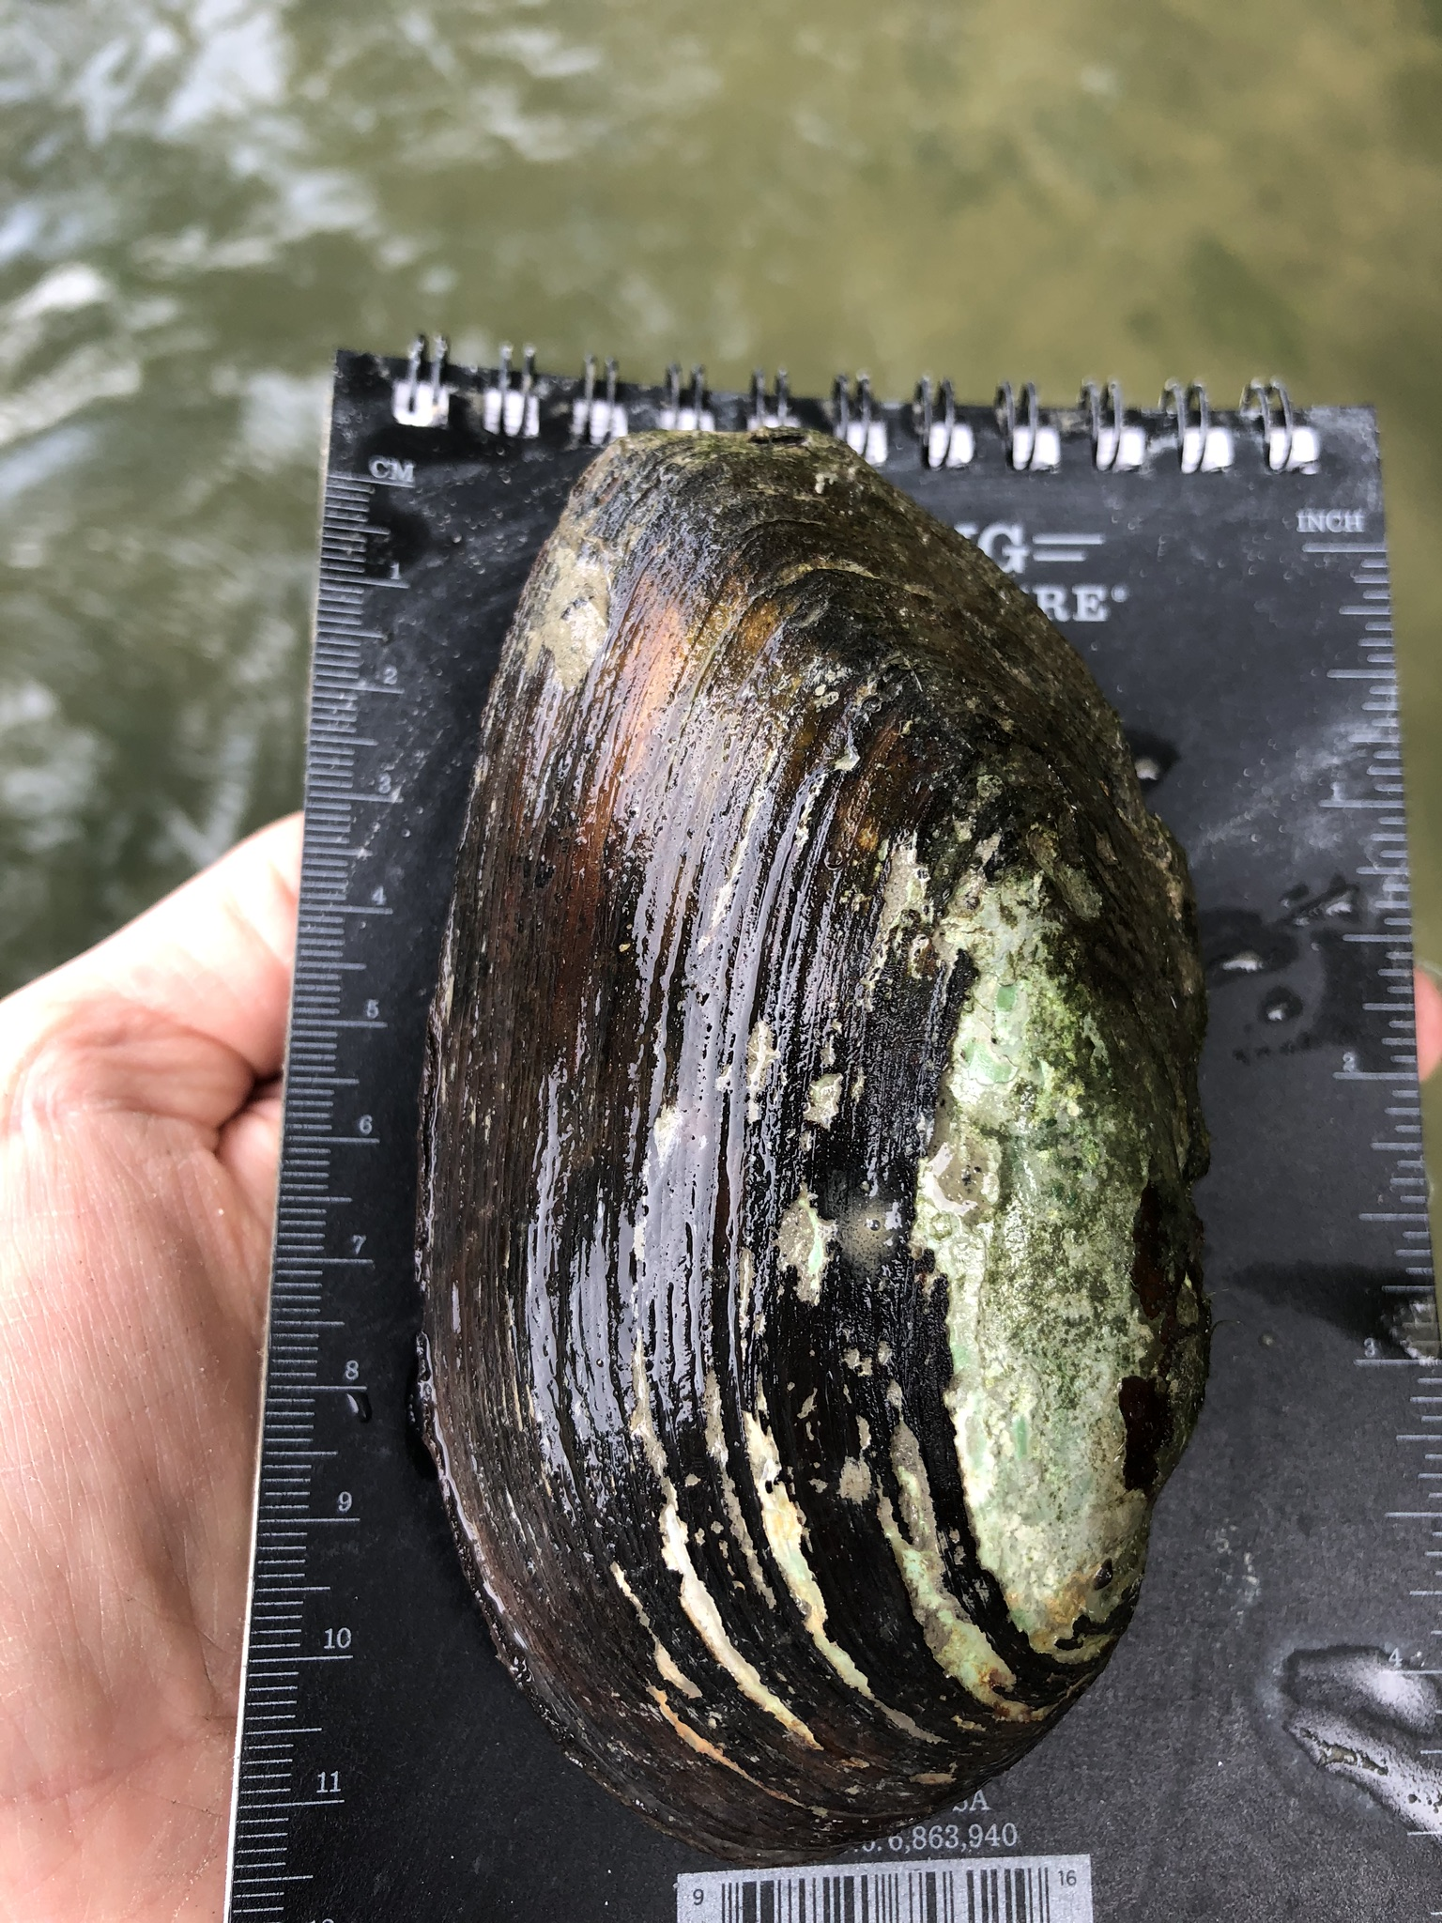
Poultney River: 13 species
Elliptio complanata | eastern eilliptio
Lampsilis radiata | eastern lampmussel
Lampsilis ovata | pocketbook
Strophitus undulatus | creeper
Lasmigona costata | flutedshell
Lepotodea fragilis | fragile papershell
Potamilus alatus | pink heelsplitter
Pyganodon grandis | giant floater
Ligumia recta | black sandshell
Lasmingona compressa | creek heelsplitter
Alasmidonta undulata | triangle floater
Pyganodon cataracta | eastern floater
Anodontoides ferrusacianus | cylindrical papershell

Slide 6
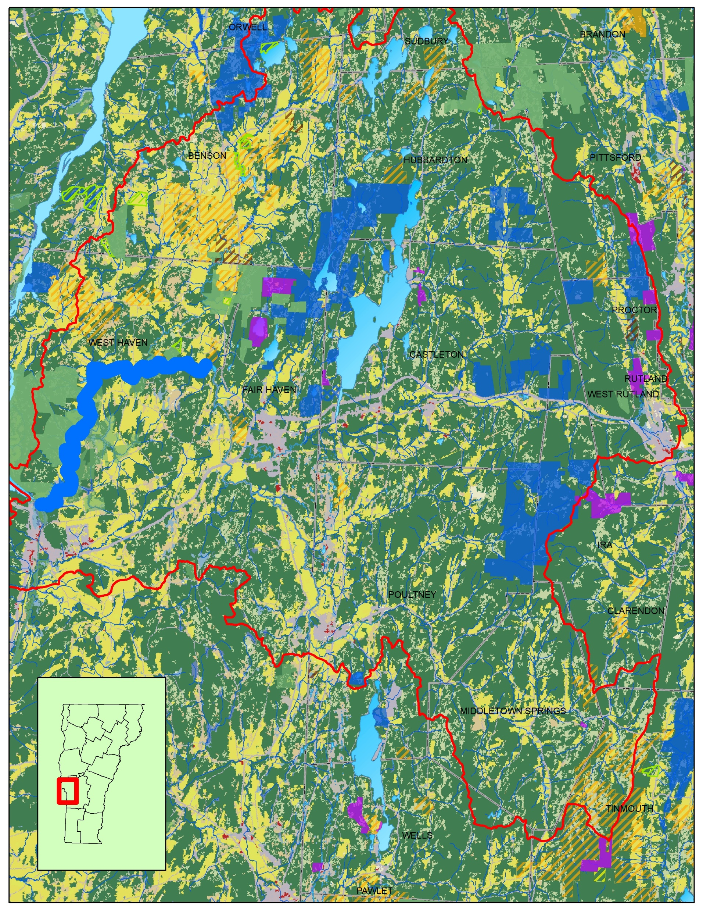
Watershed:
Lots of protected lands
TNC riverbank protection = 13.9 miles (58%)
Lots of forests

Slide 7
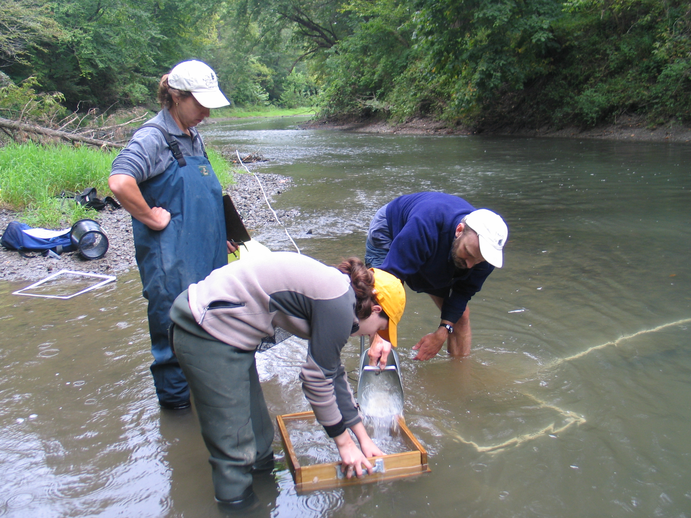
30 year Poultney River mussel sampling history
1990 – 1992 Chris Fichtel VT F&W
Qualitative, semi-quantitative sampling, bed counts
-1997 Dave Smith USGS
-2006 – 2018 Marangelo TNC
“Book Farm” in West Haven VT
Quantitative sampling
2019 Marangelo and Lew-Smith
Re-survey early 1990’s sites
Qualitative and semi-quantitative sampling

Slide 8
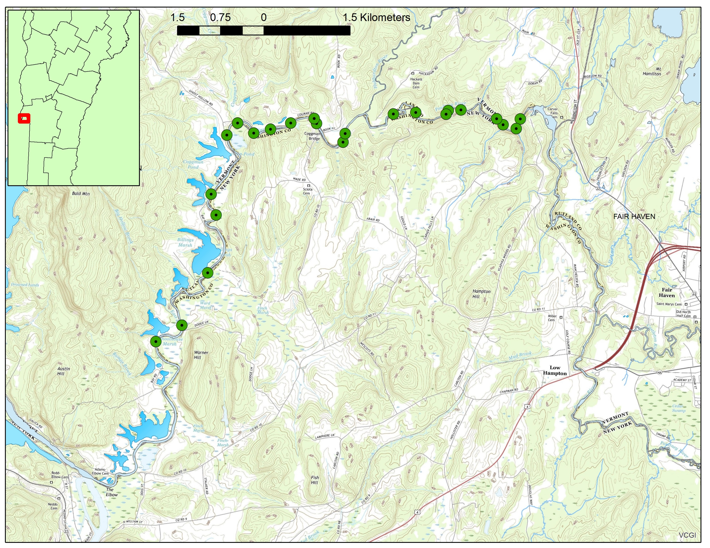

Slide 9
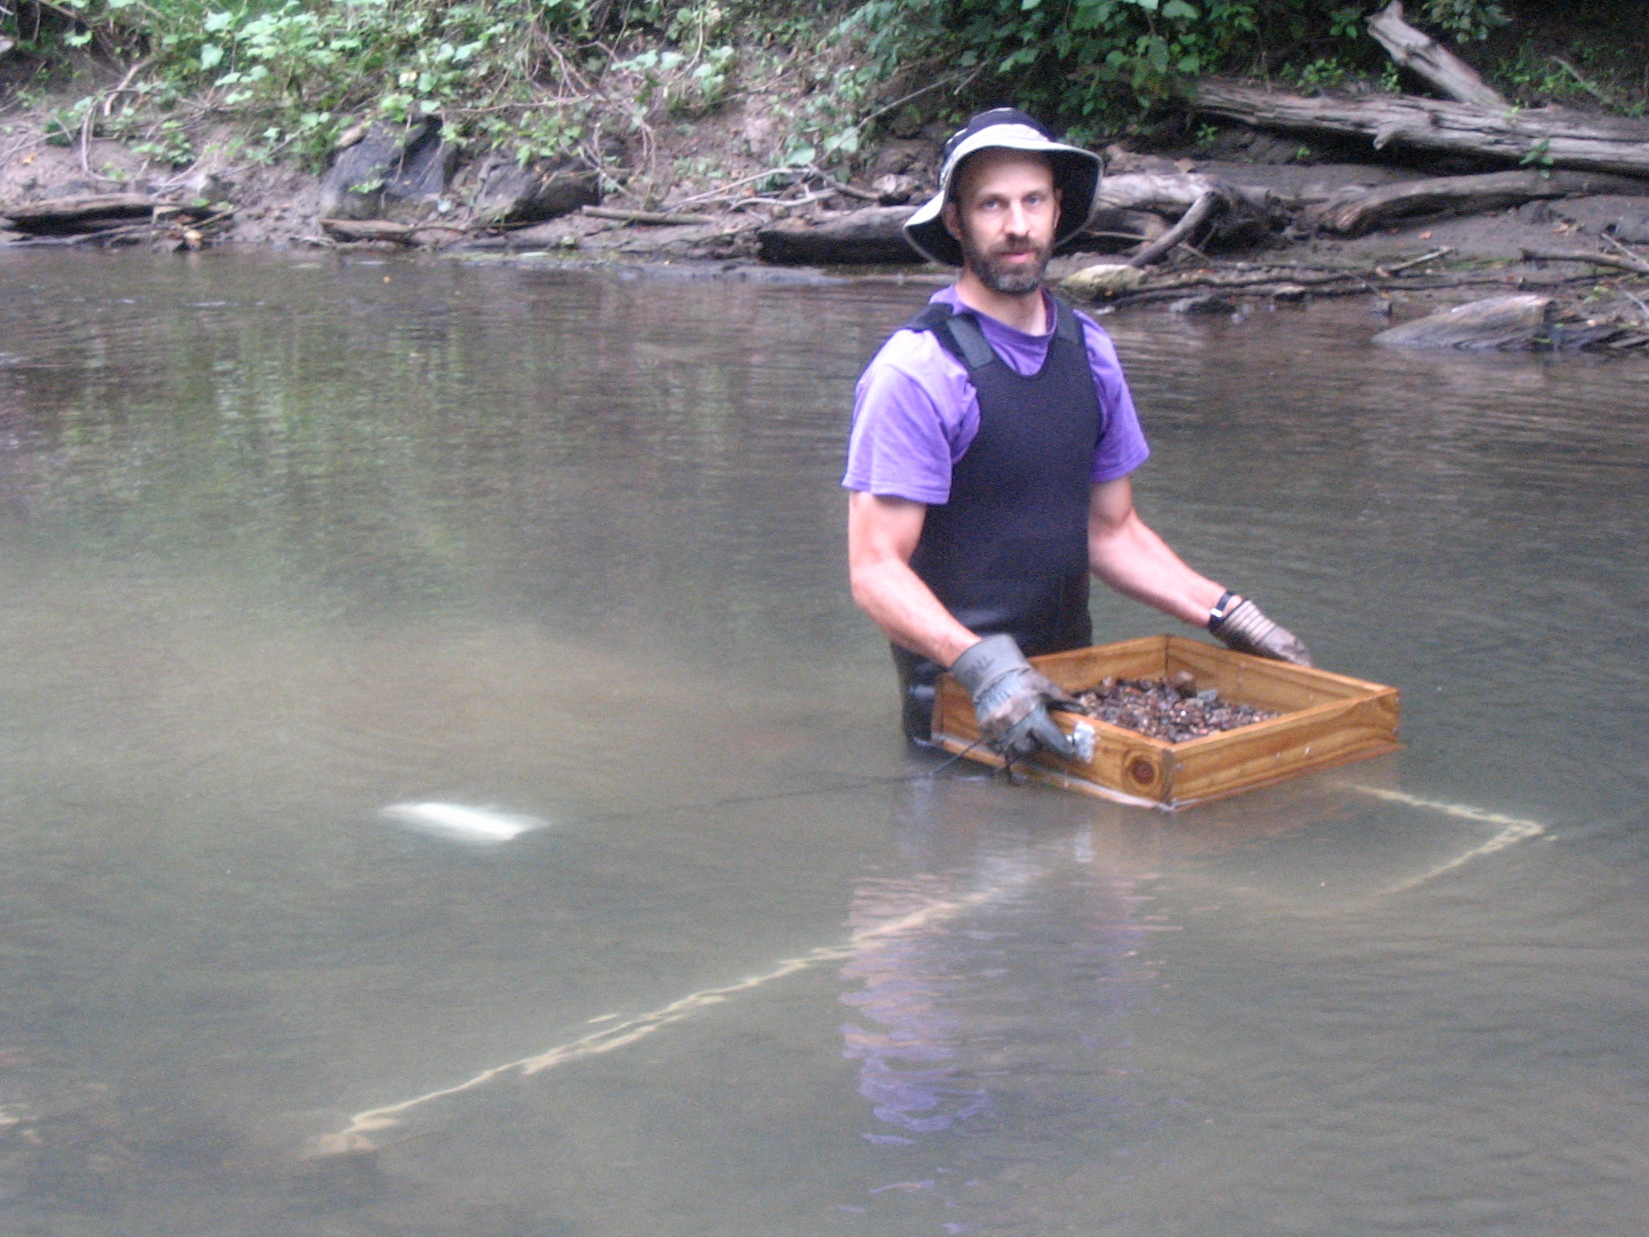
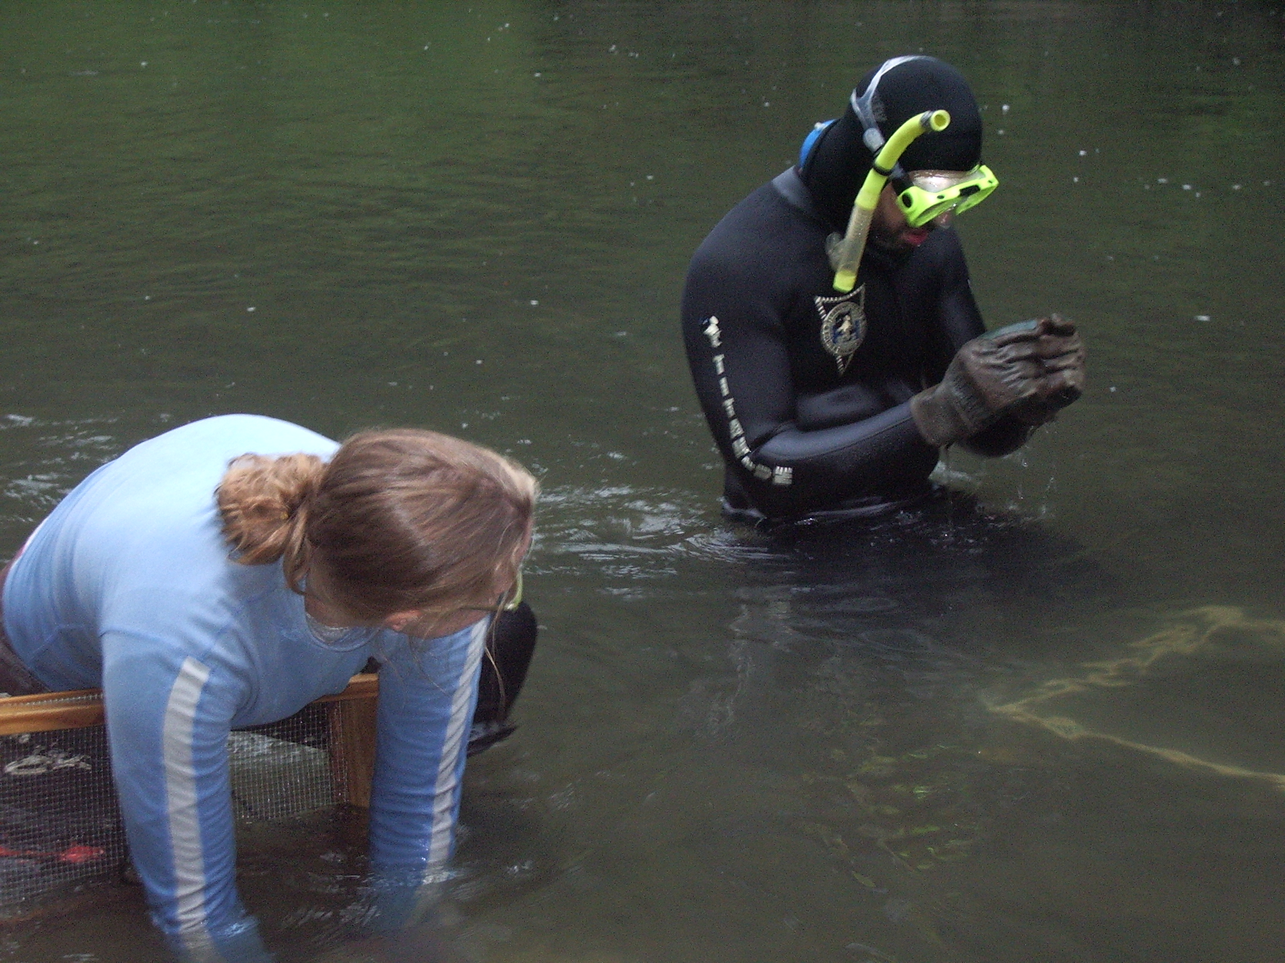
Quantitative sampling
Quantitative:
Most precise way of sampling: abundance data (#/m²)
Detection of small individuals and juveniles

Slide 10
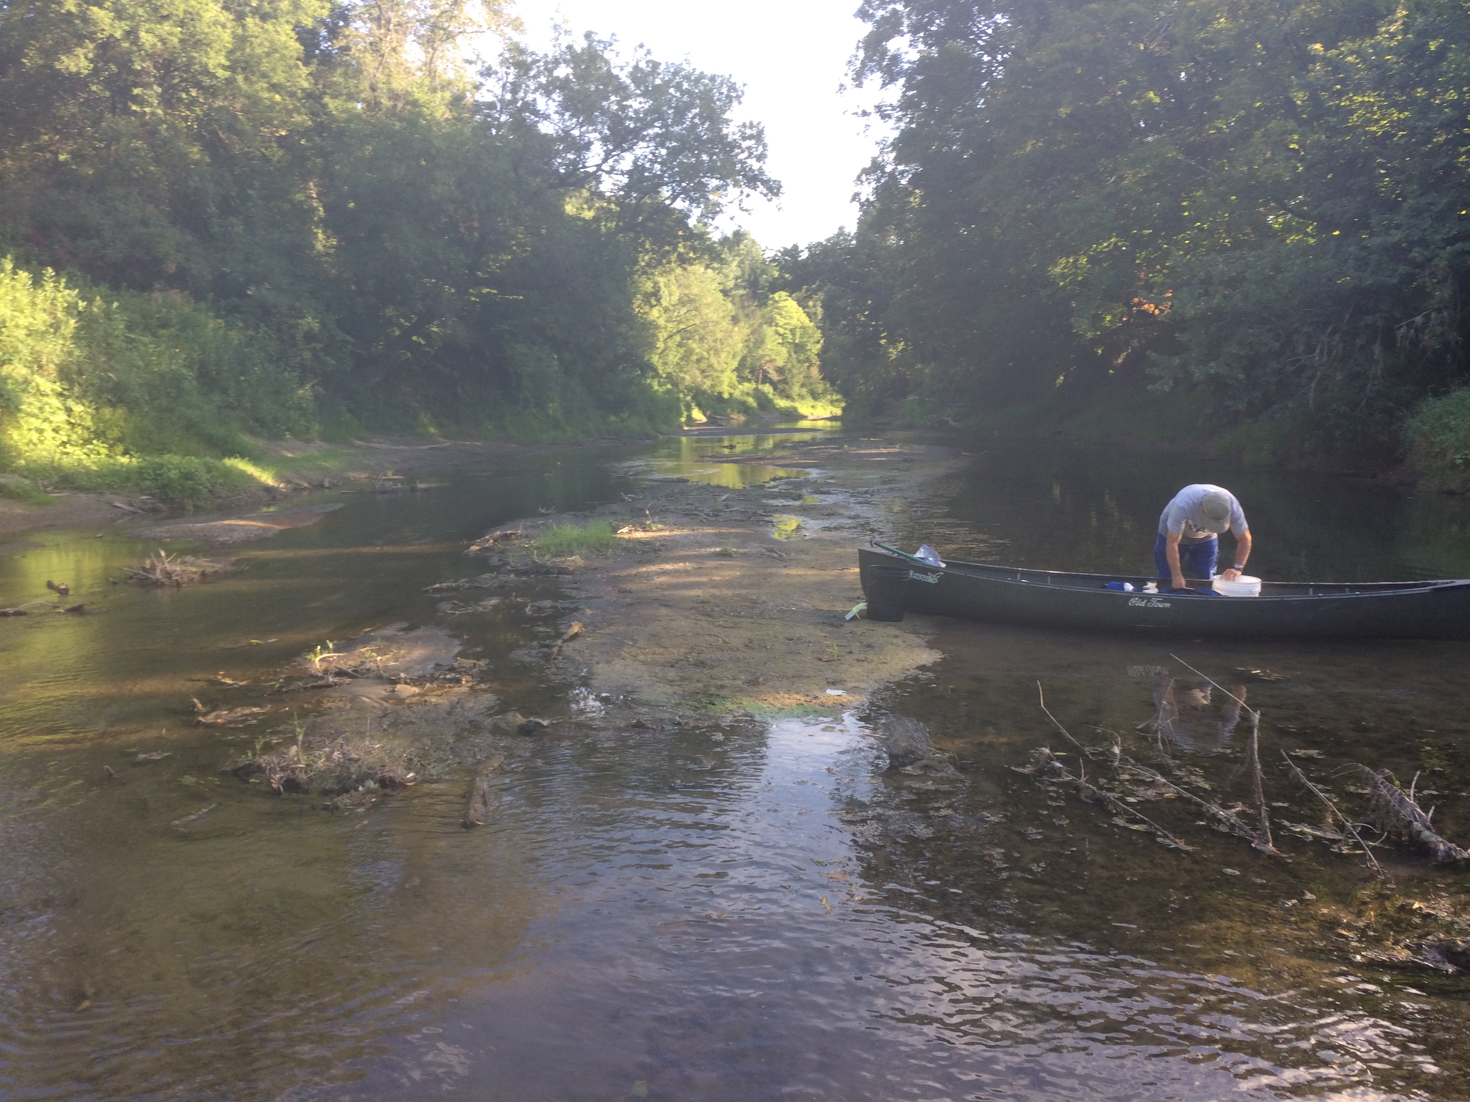
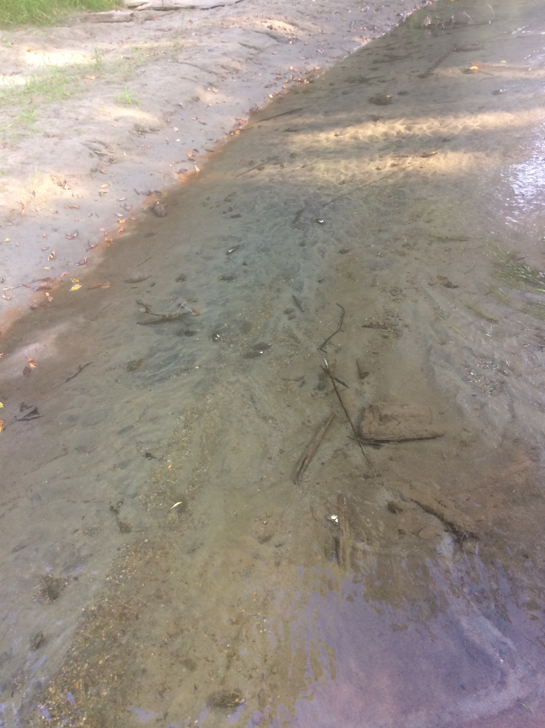
“Book Farm” site, West Haven VT 1997-2018
74% decline in #/0.25m2 since 1997
52% decline #/0.25m2 since 2007

Slide 11
“Book Farm” quantitative surveys 1997 vs 2018
1997 data from Dave Smith, USGS

Slide 12
Book Farm 1997 vs 2018

Slide 13
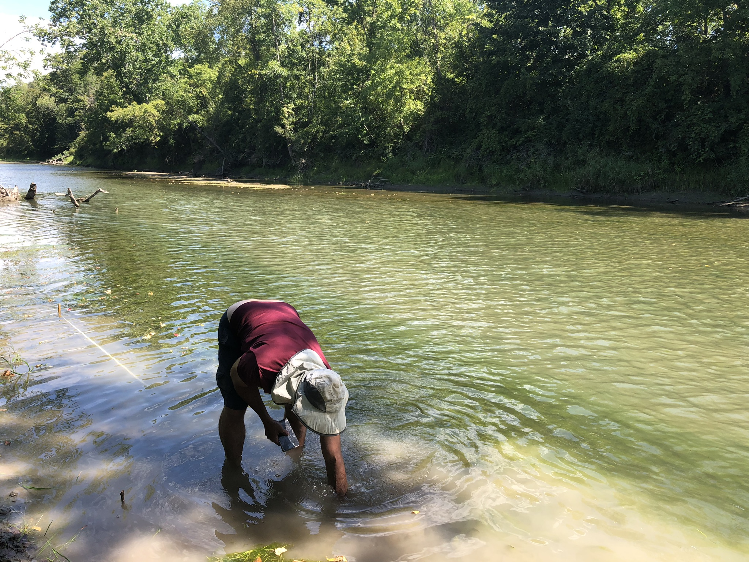
Semi-quantitative sampling
Search 1m wide area along a transect within mussel beds
Approximate # of mussels per m²
Less sensitive for detecting juveniles/small mussels

Slide 14
Site 5 transect sampling (semi-quantitative)
66% decline

Slide 15
Site 11 transect sampling (semi-quantitative)
95% increase*

Slide 16
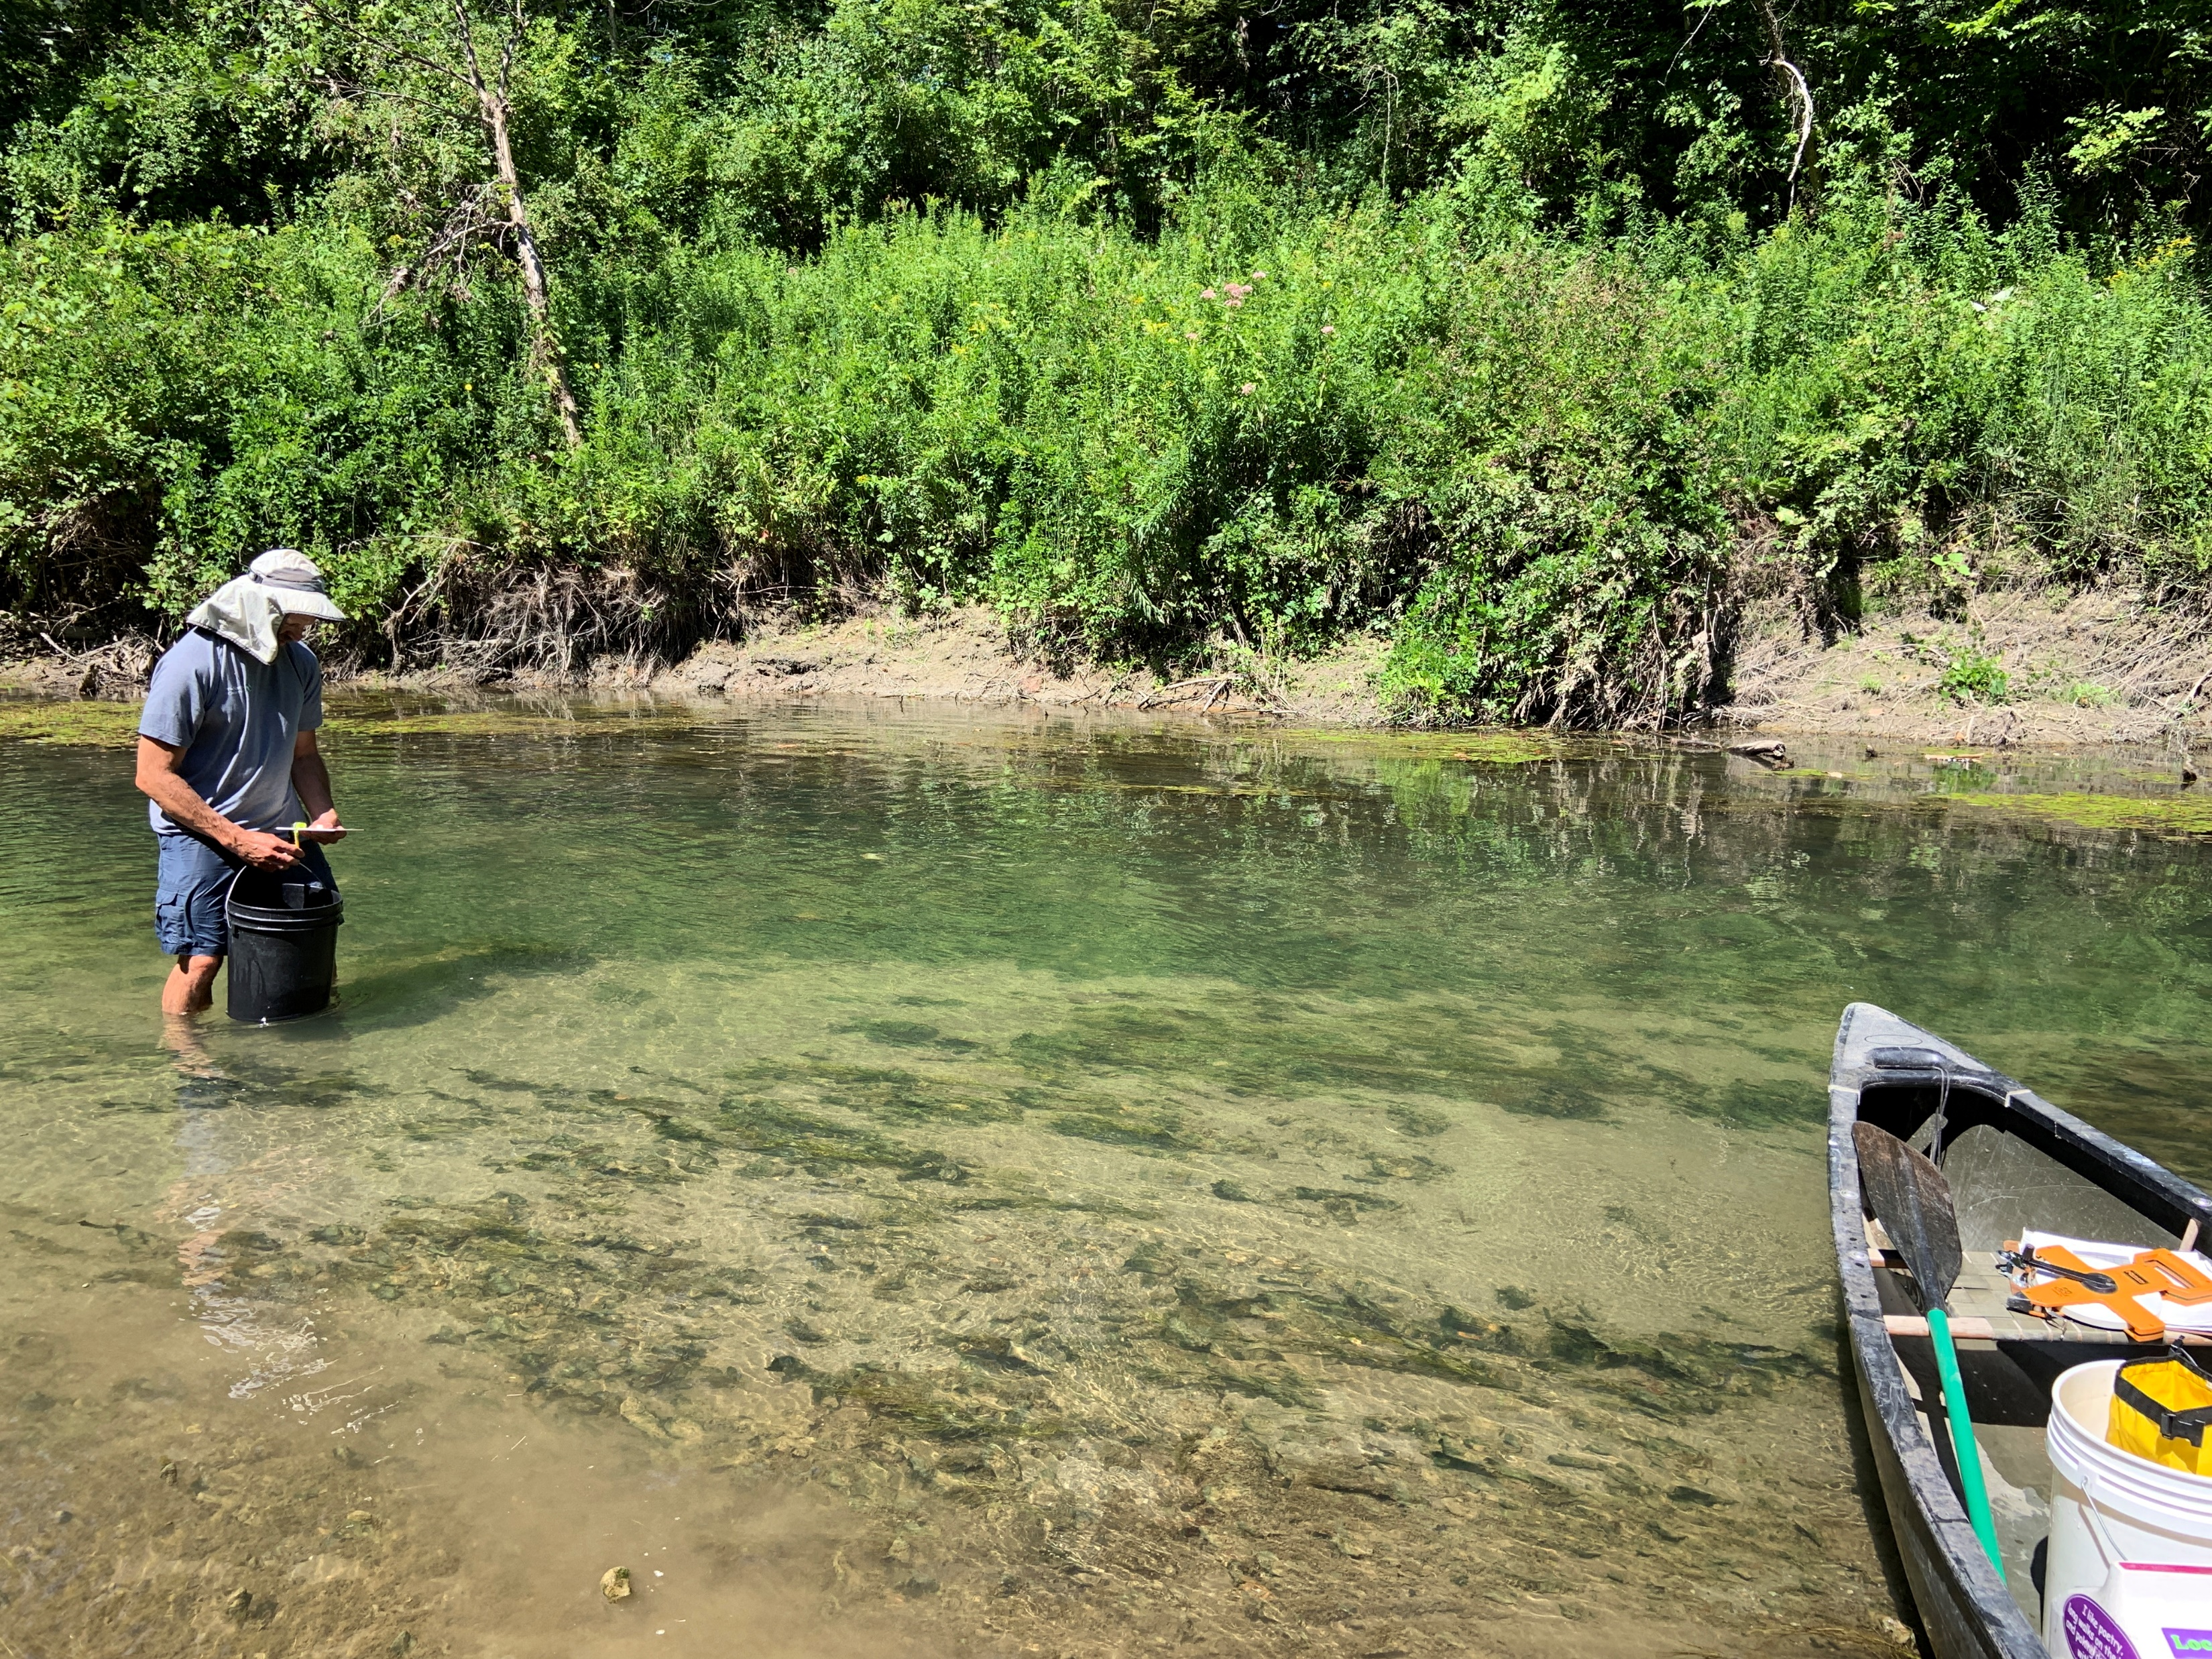
Qualitative sampling
Timed searches within mussel beds
Catch per unit effort (mussels per hour)
Best way to detect rare species

Slide 17
Early 90’s
2019

Slide 18
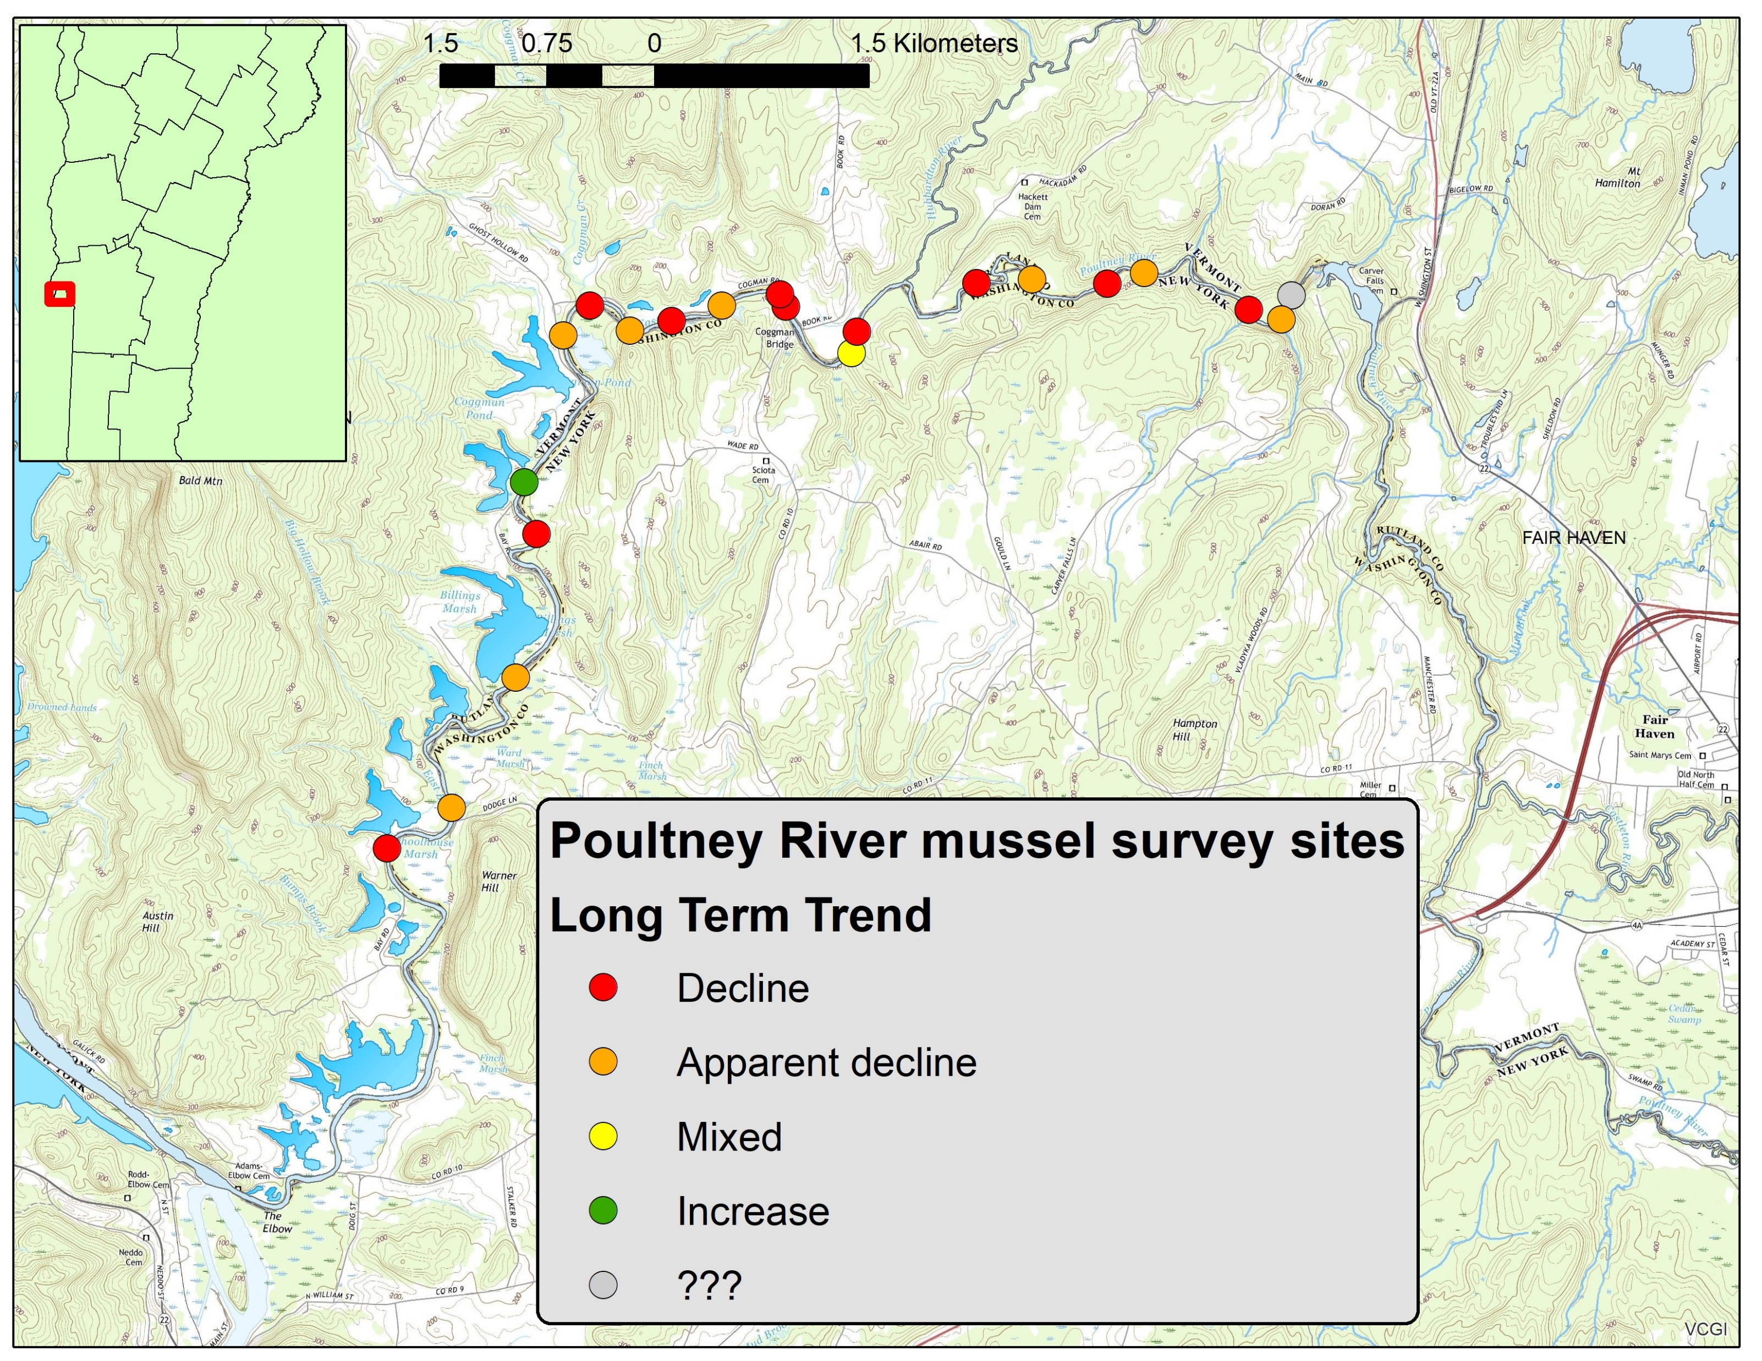

Slide 19
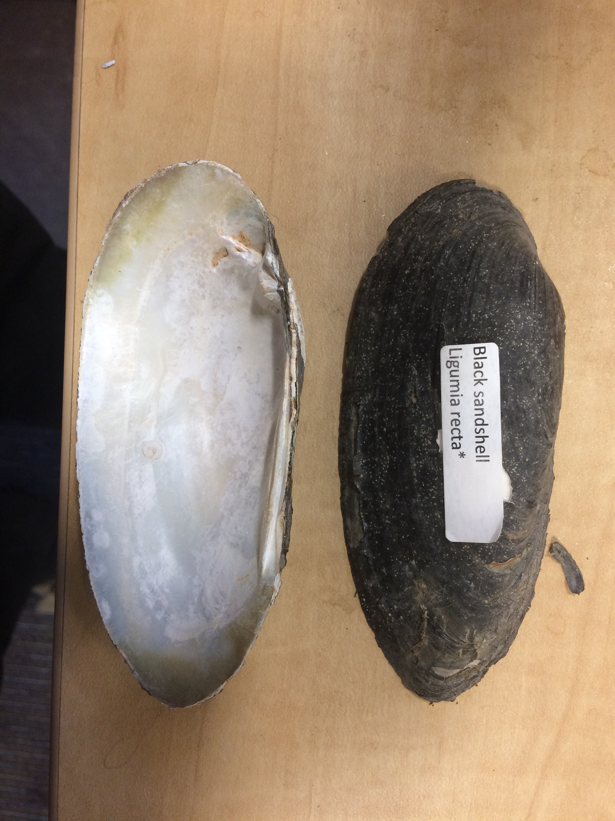
Cumulative numbers
 | 1990 - 92 | 2019
Elliptio complanata | 7603 | 1020
Lampsilis ovata | 552 | 18
Lampsilis radiata | 753 | 570
Lasmigona costata | 74 | 22
Lasmingona compressa | 1 | 0
Leptodea fragilis | 265 | 11
Ligumia recta | 21 | 0
Potamilus alatus | 134 | 66
Pyganodon grandis | 51 | 0
Strophitus undulatus | 67 | 11
totals | 9521 | 1718

Slide 20
Total number of mussels found
7,600

Slide 21
Changes in relative abundance

Slide 22
Summary (Poultney)
Severe to moderate decline in abundance of most rare species and common species
Fewer productive sites – many of the 1992 sites diminished abundance and spatial distribution (less extensive “beds”)

Slide 23
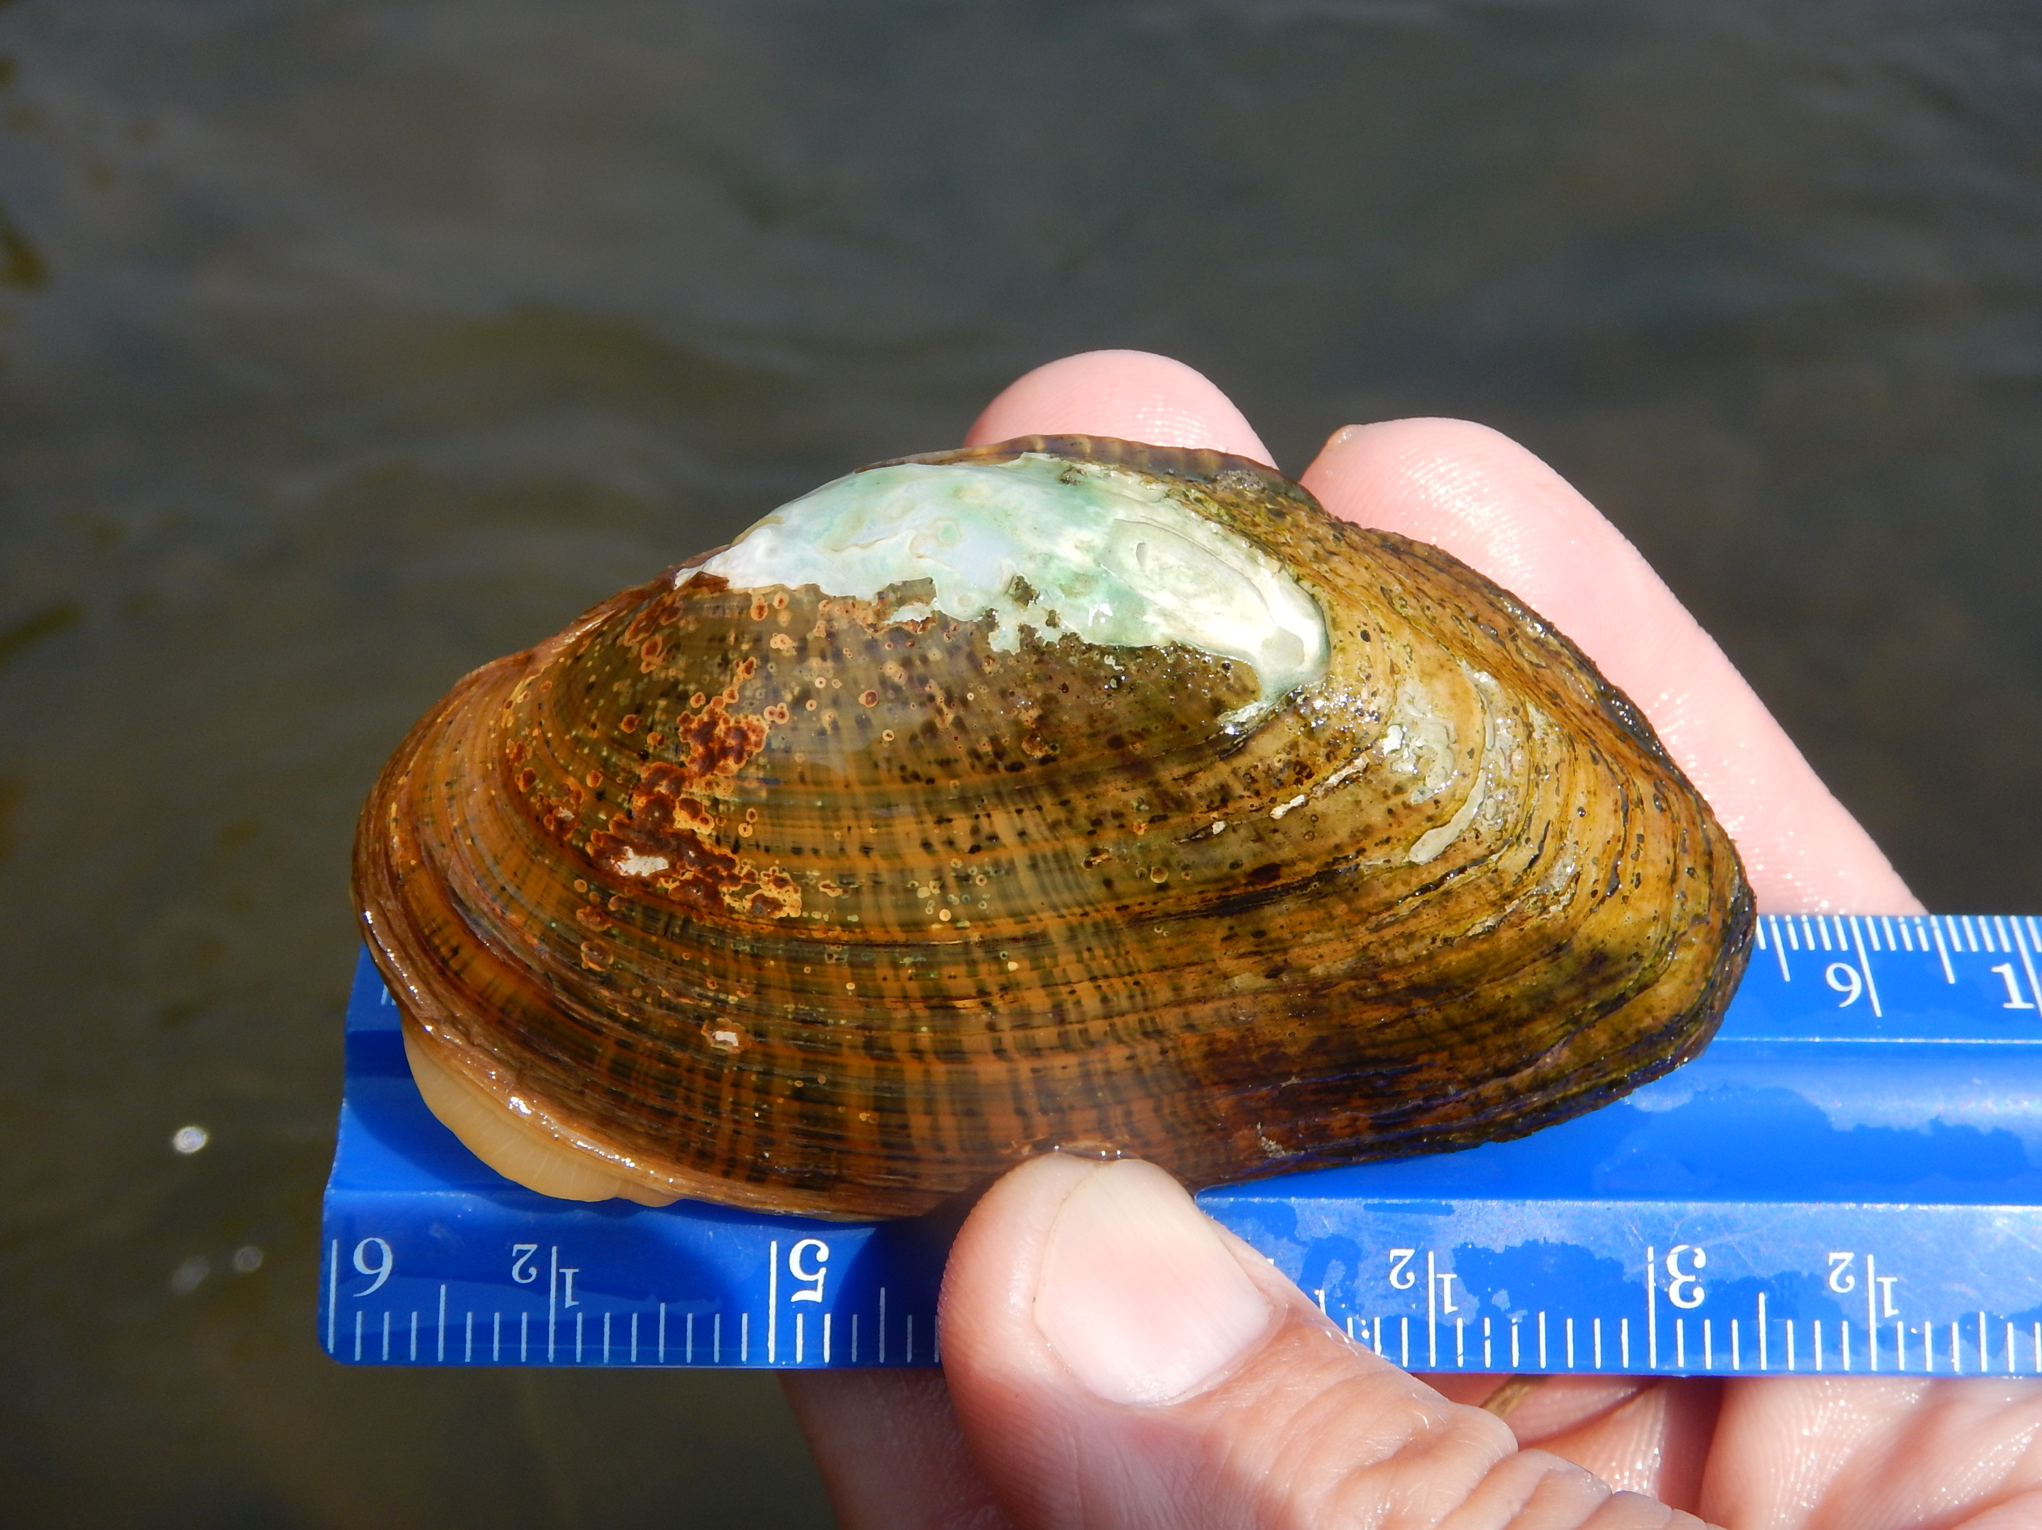
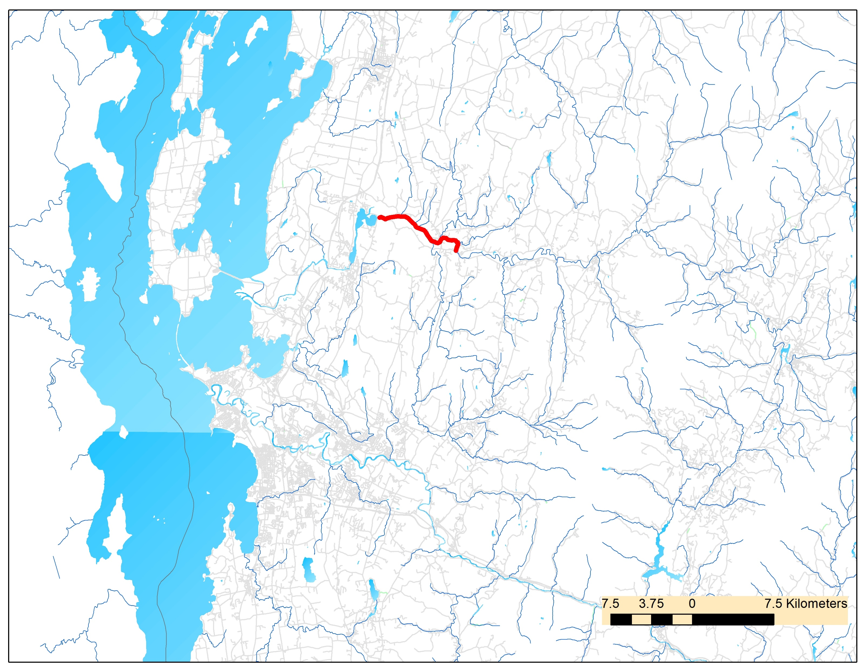
Lamoille River 2019 Surveys
Surveyed Fairfax Falls to Arrowhead Lake to better document the Elktoe (Alasmidonta marginata)
Only known occurrence of this species in Vermont; first discovered in 2000
Follow up on initial 2001 survey (Christine O’Brien, 2002)

Slide 24
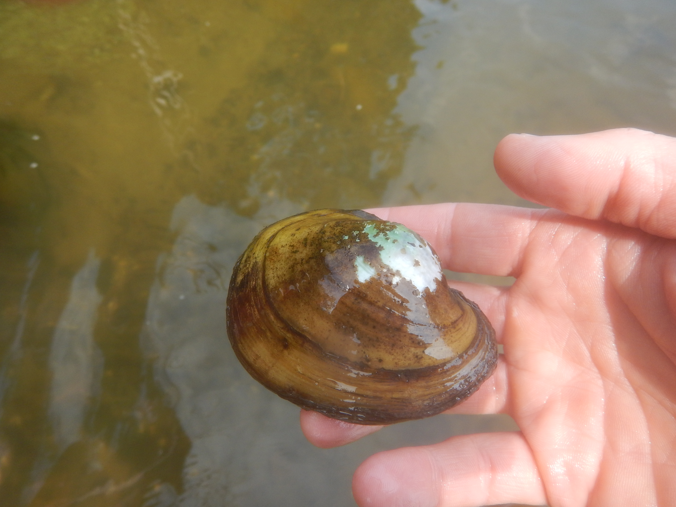
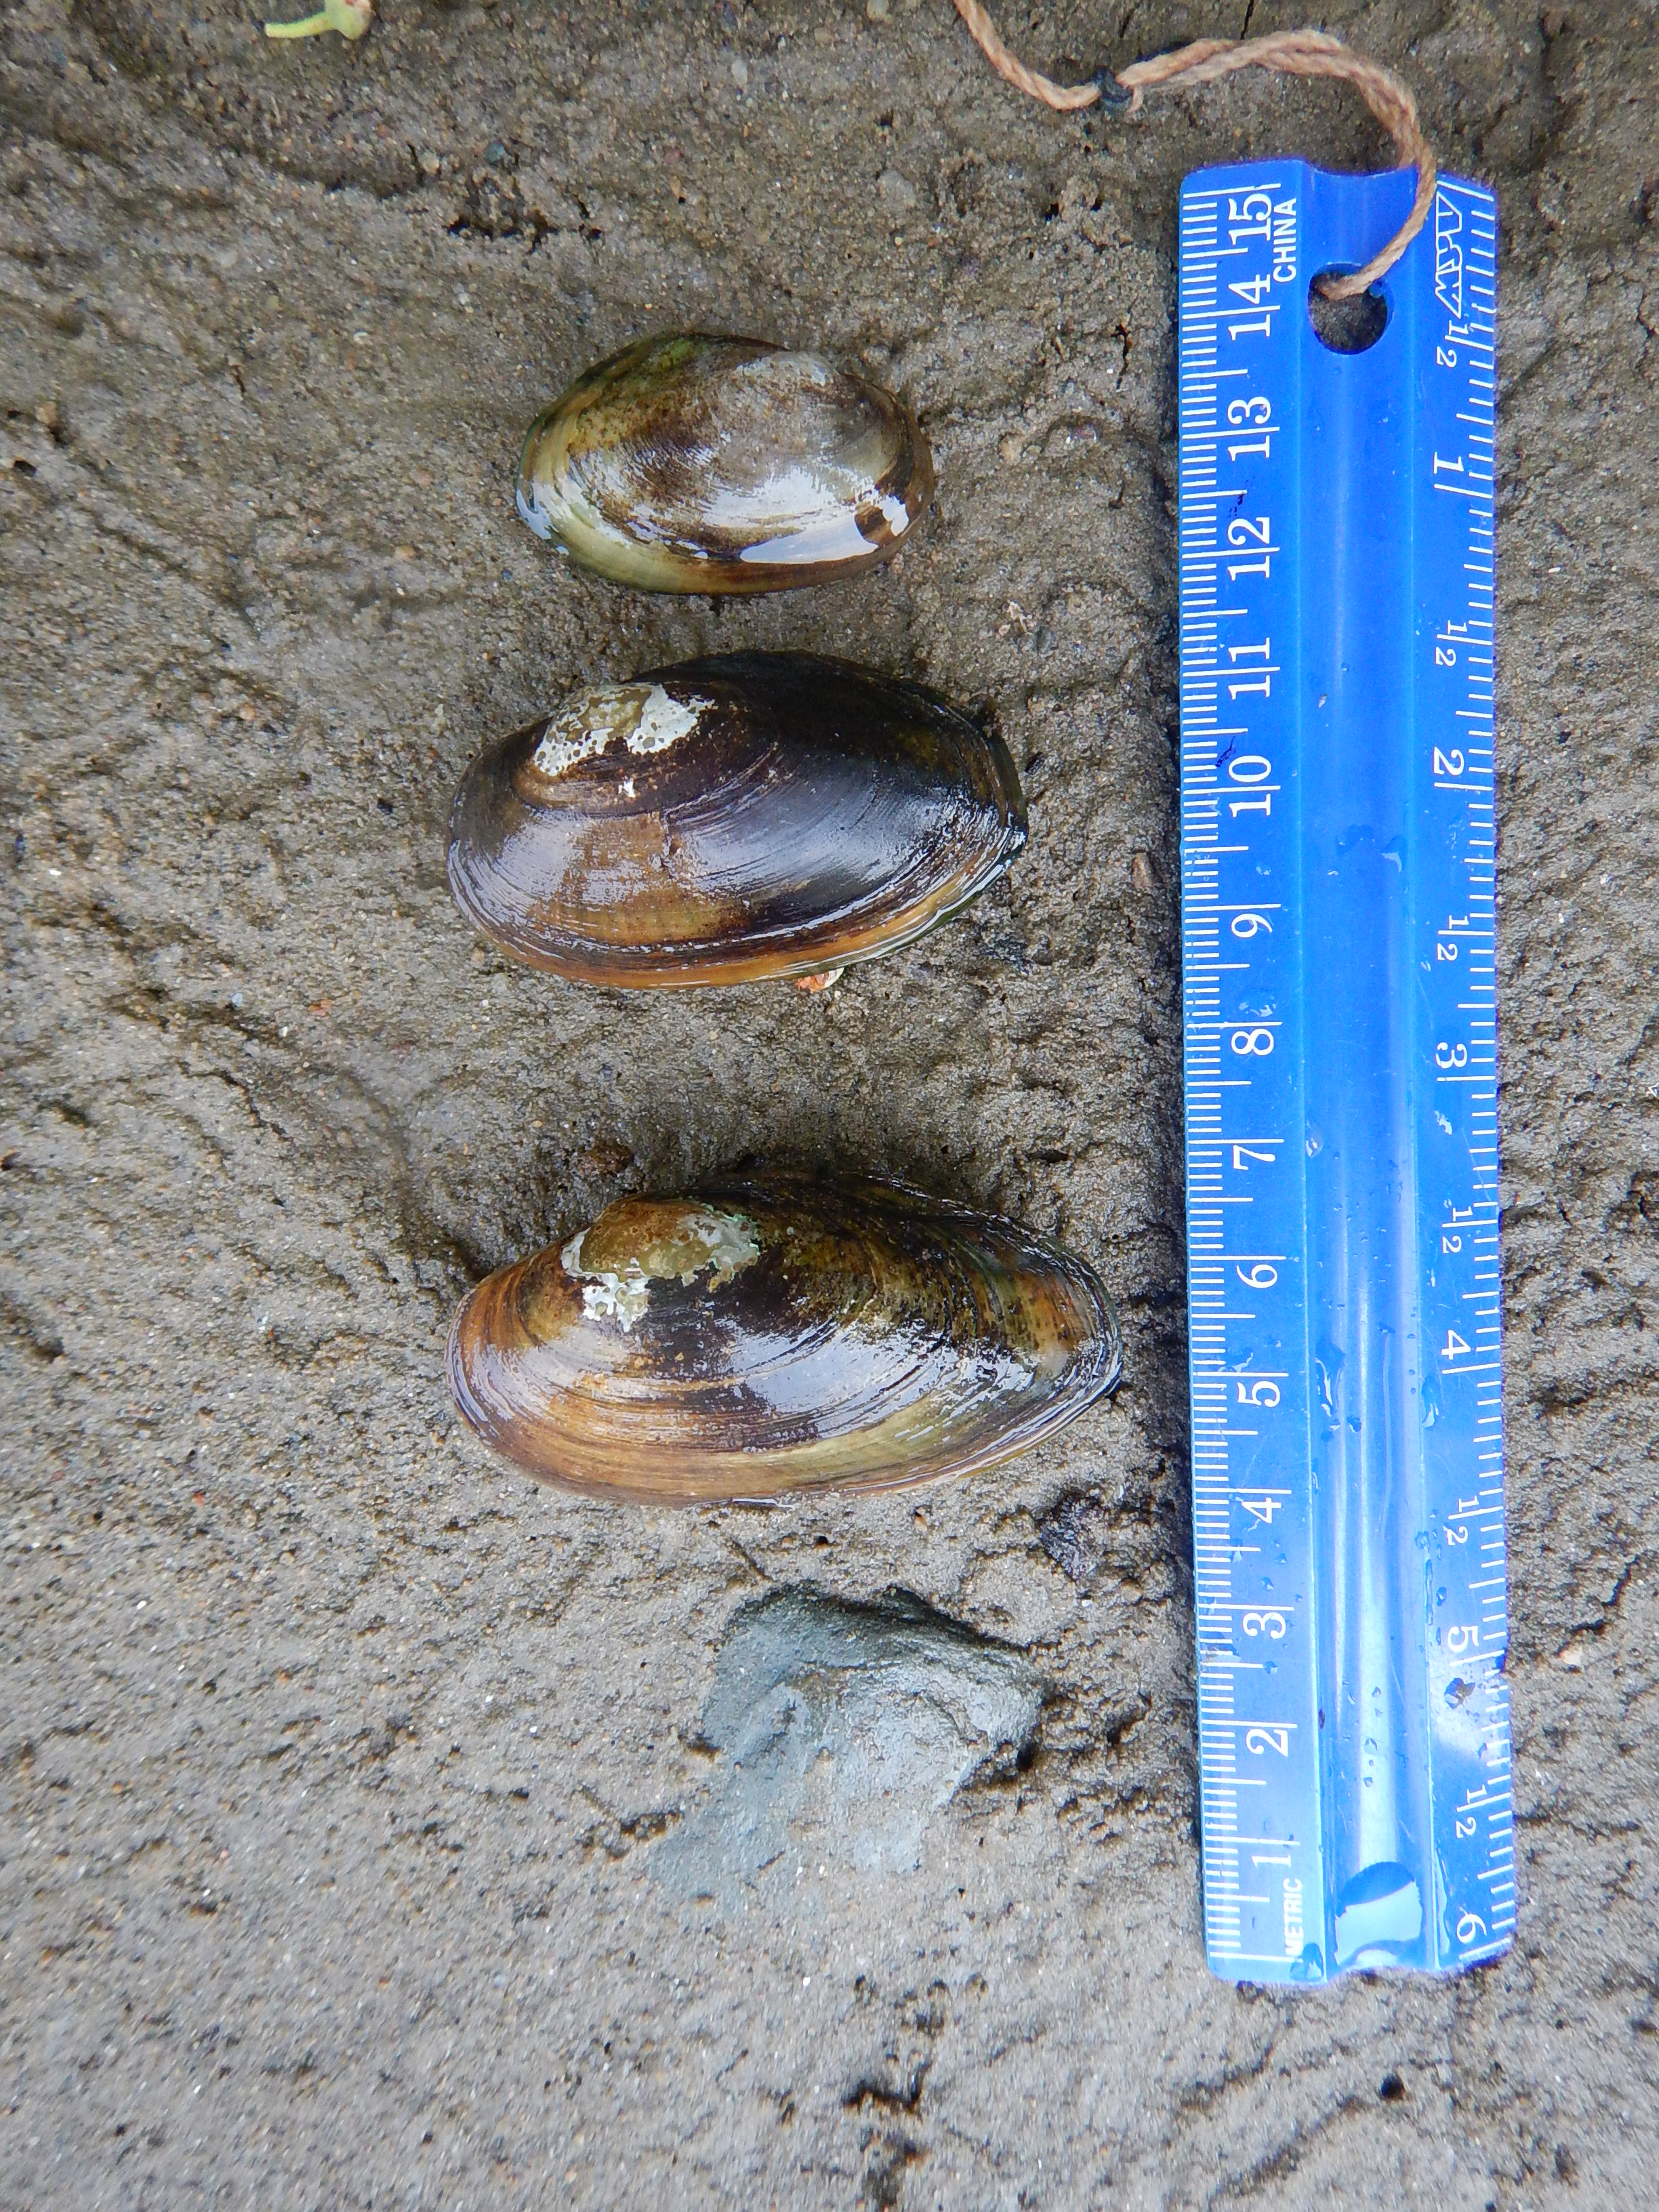
Results and comparison
species | # found | %
Alasmidonta marginata | 6 | 0.4%
Anodontoides ferrusacianus | 8 | 0.6%
Elliptio complanata | 810 | 60.5%
Lampsilis radiata | 510 | 38.1%
Lasmigona compressa | 2 | 0.1%
Lampsilis ovata | 3 | 0.2%
2001: 0.53 elktoe per search hour
2019: 0.59 elktoe per search hour

Slide 25
Poultney River Mussel Decline:
Commonly cited mussel stressors (sedimentation, nutrient loading, host fish populations, etc)
“Enigmatic mussel decline”
Estrogen mimics, microplastics
Habitat Disturbances from fluvial geomorphic adjustment processes

Slide 26
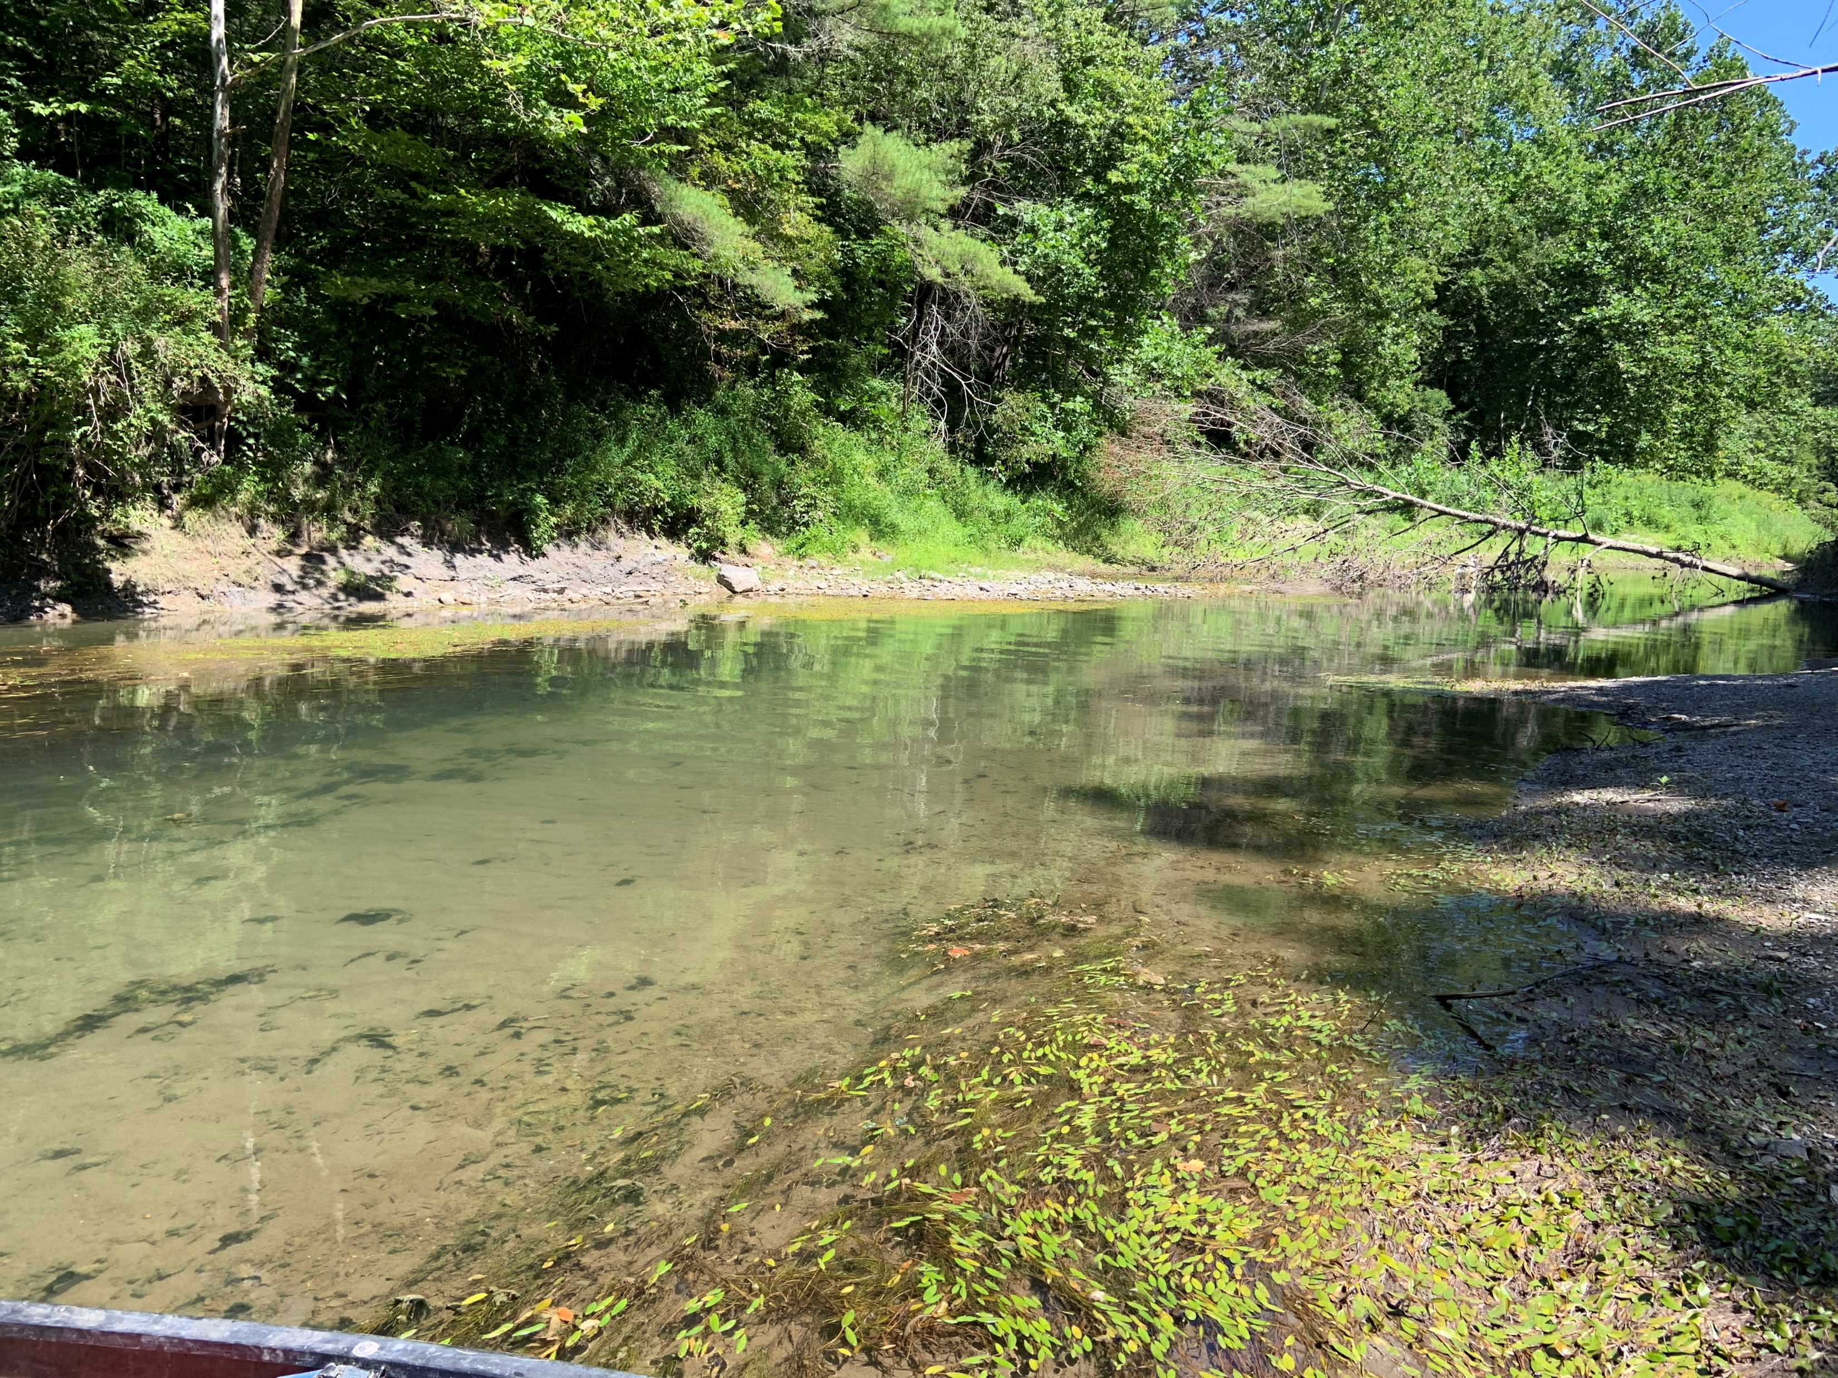
Wastewater treatment facilities
West Rutland
Castleton
Fair Haven
Poultney

Slide 27
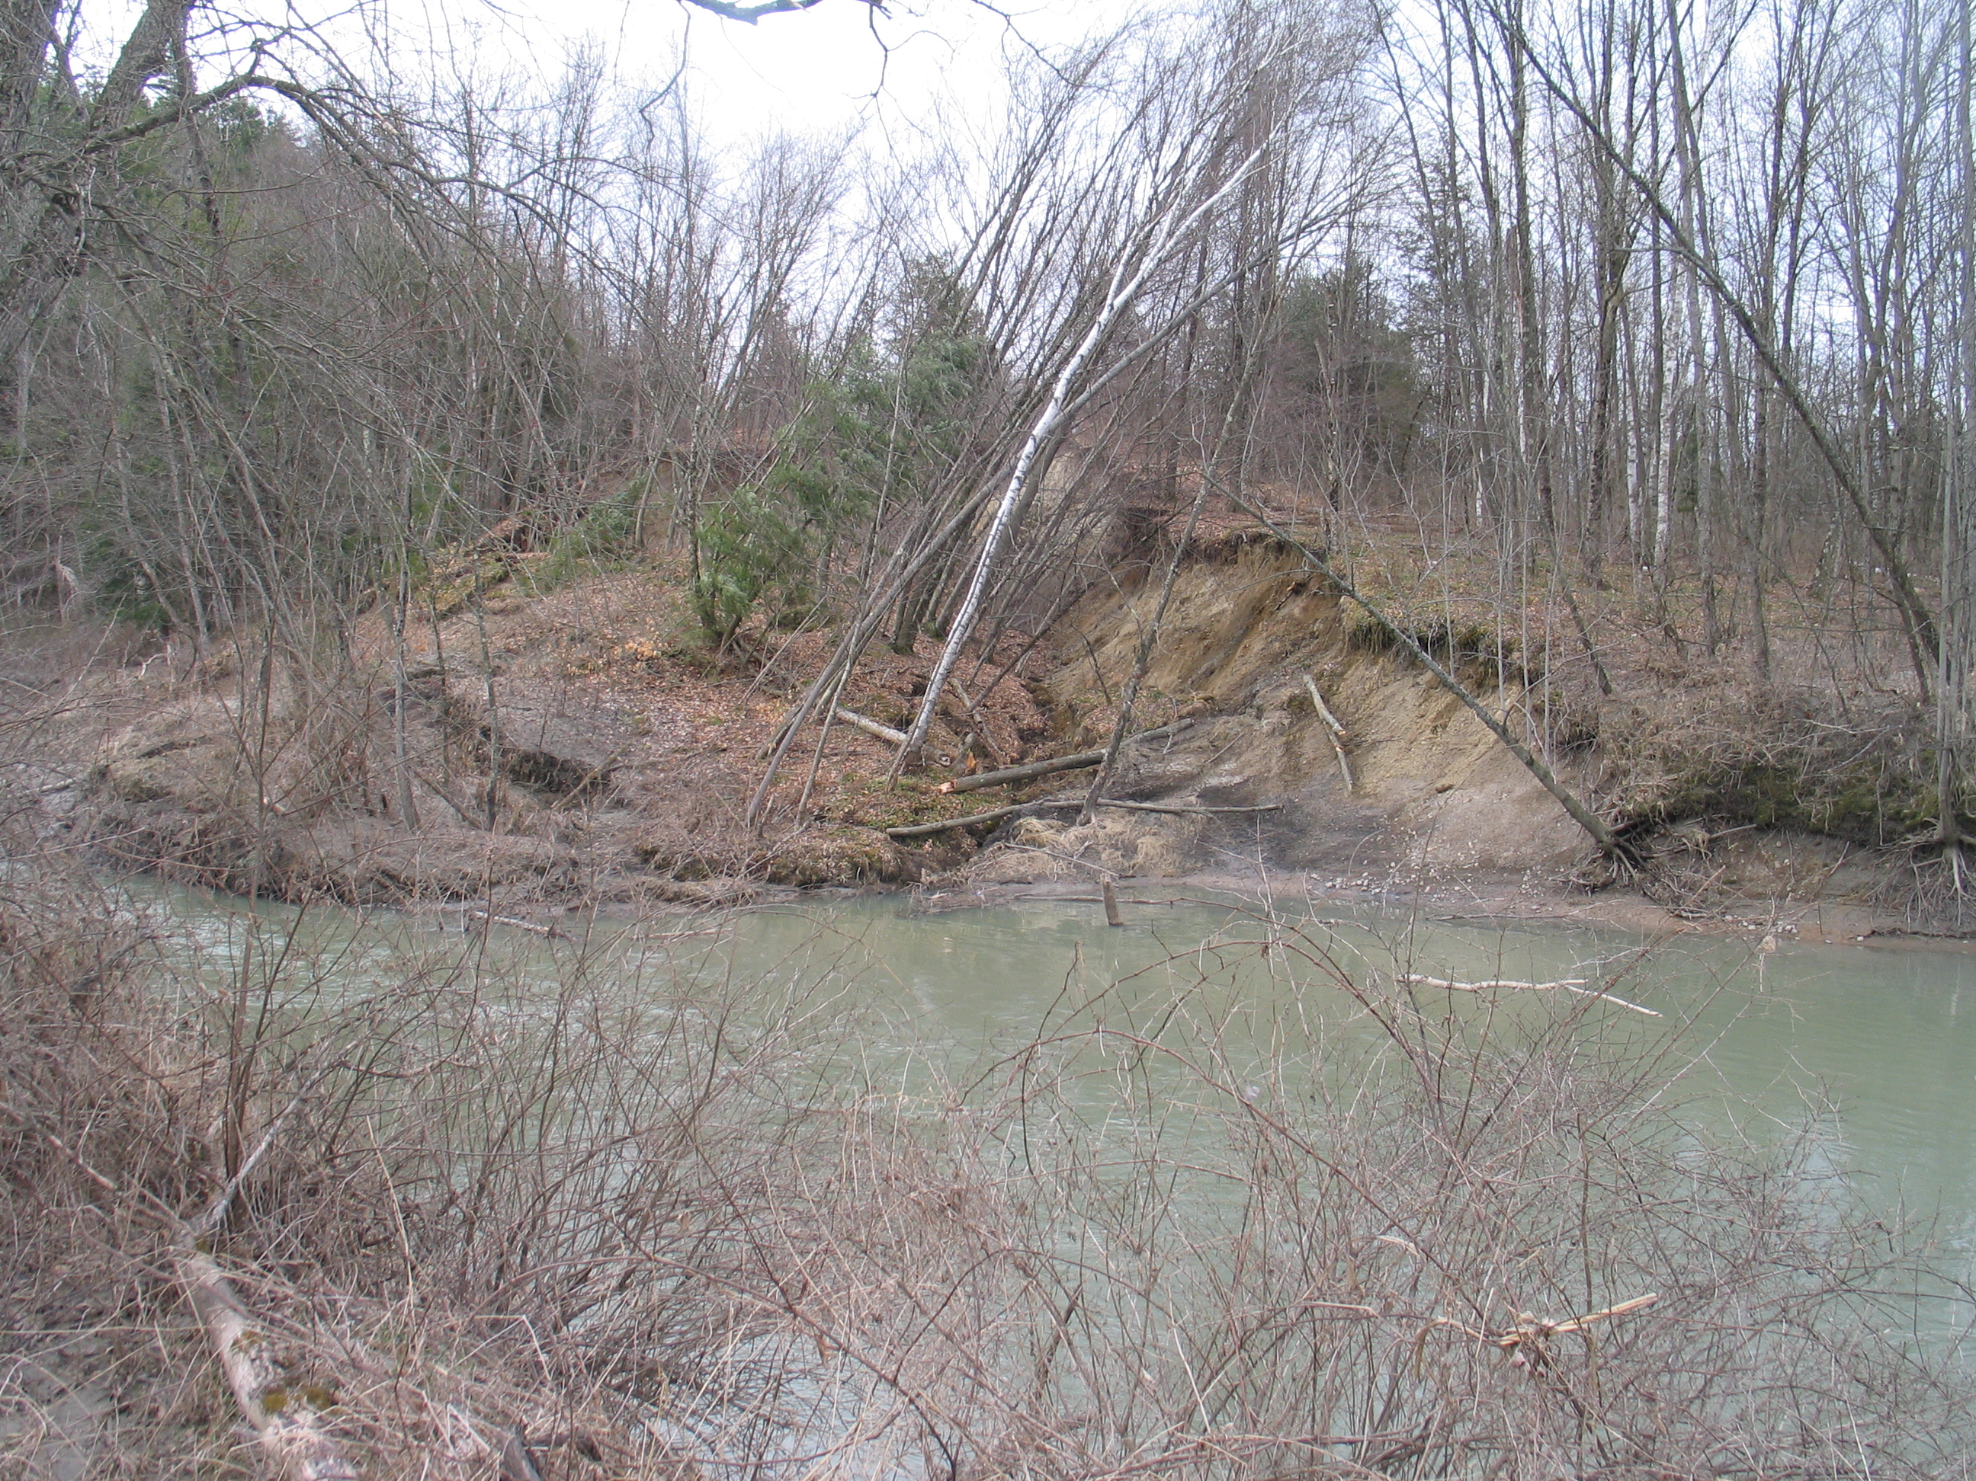
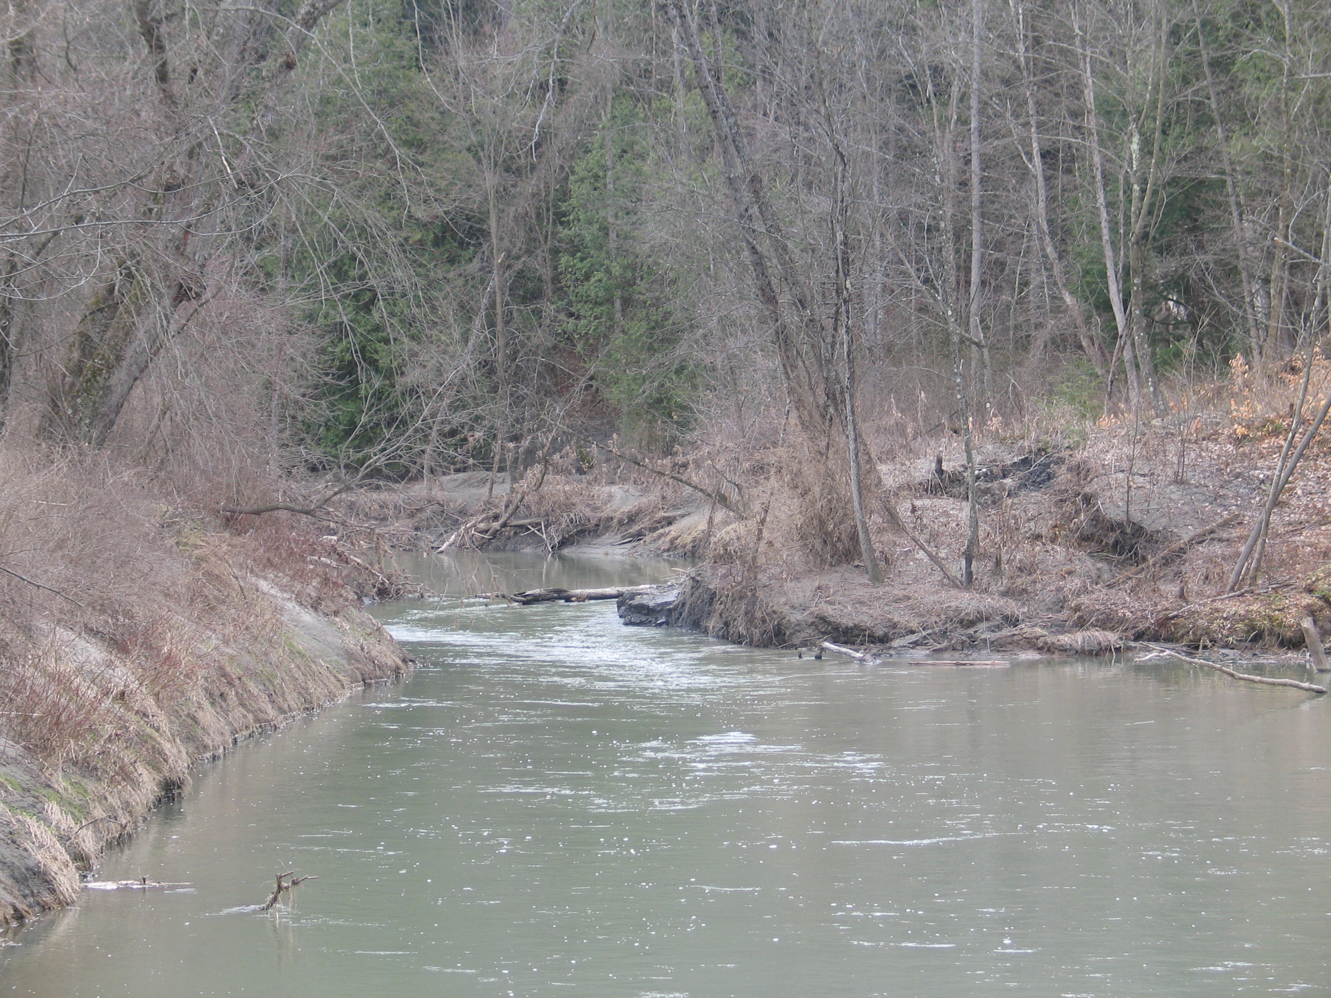
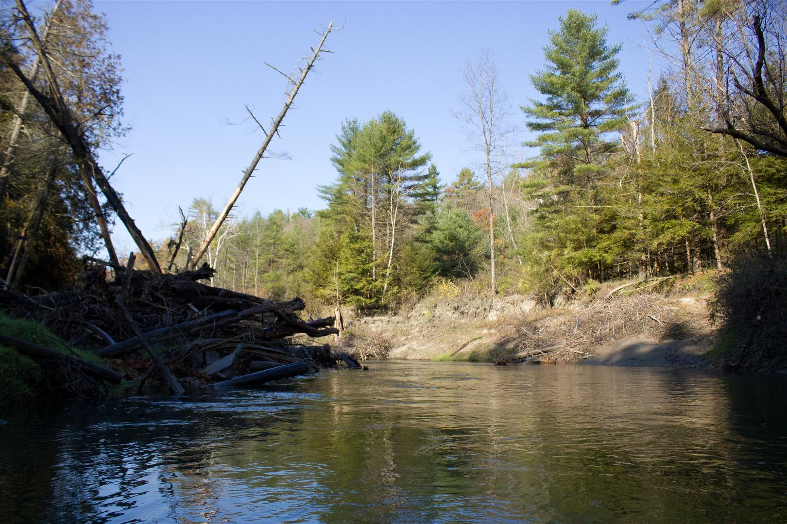
Lower Poultney Channel Instability

Slide 28
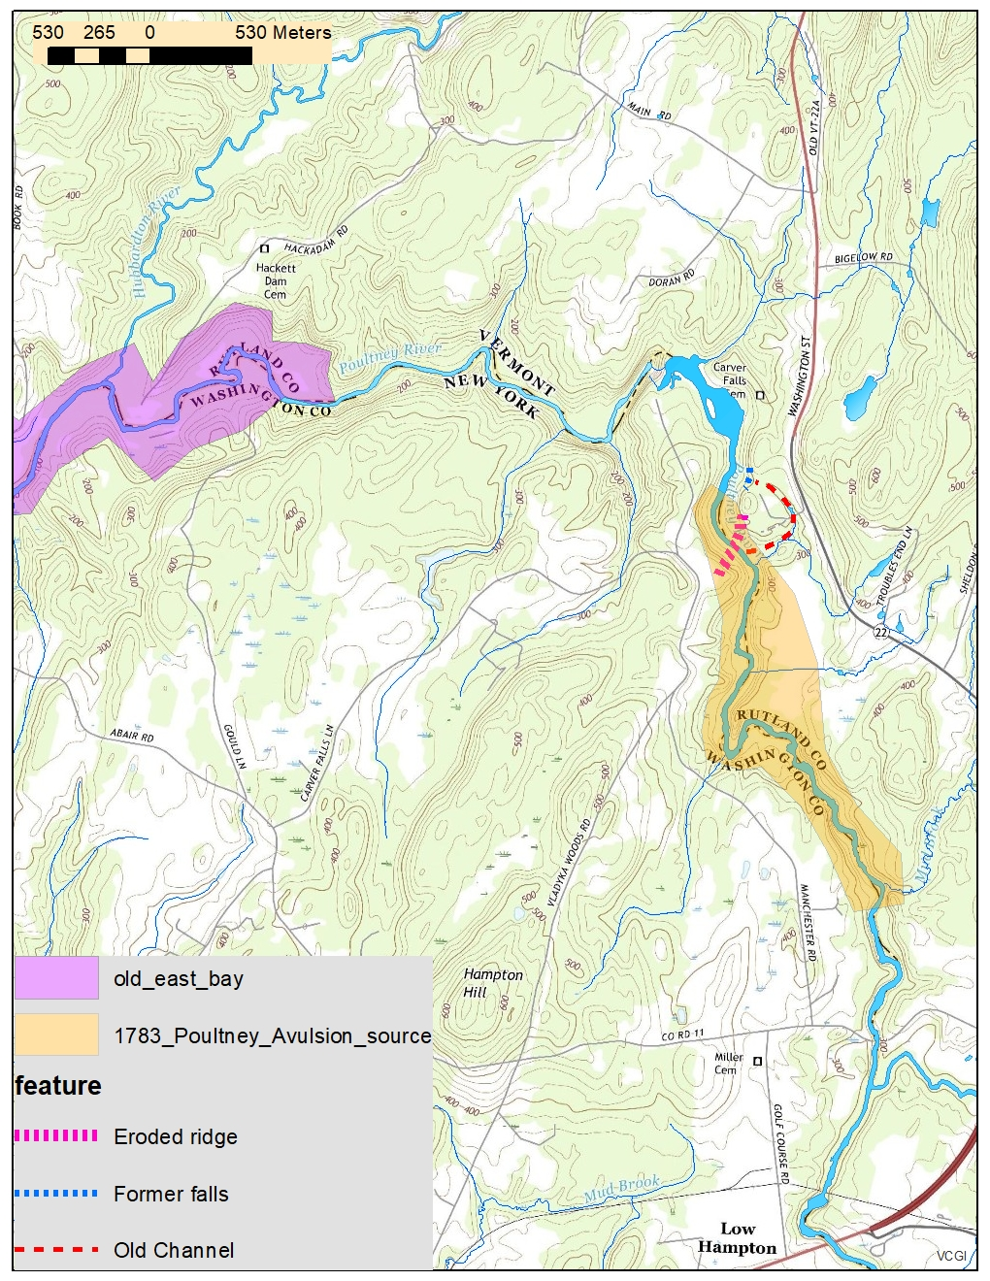
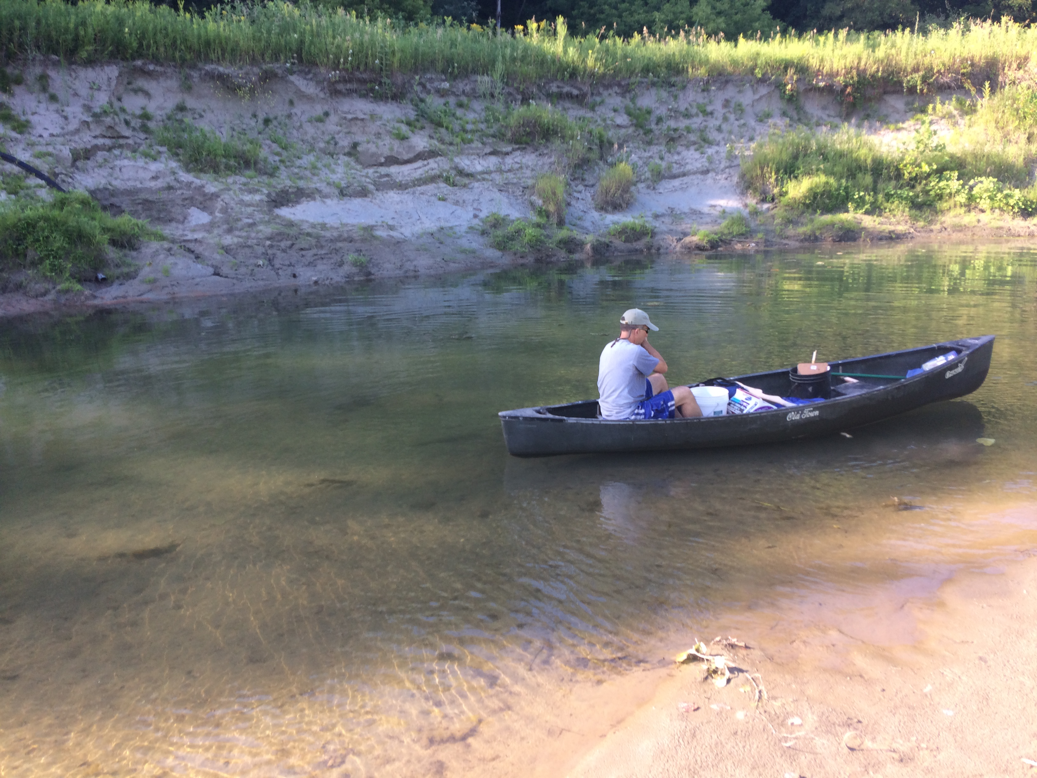
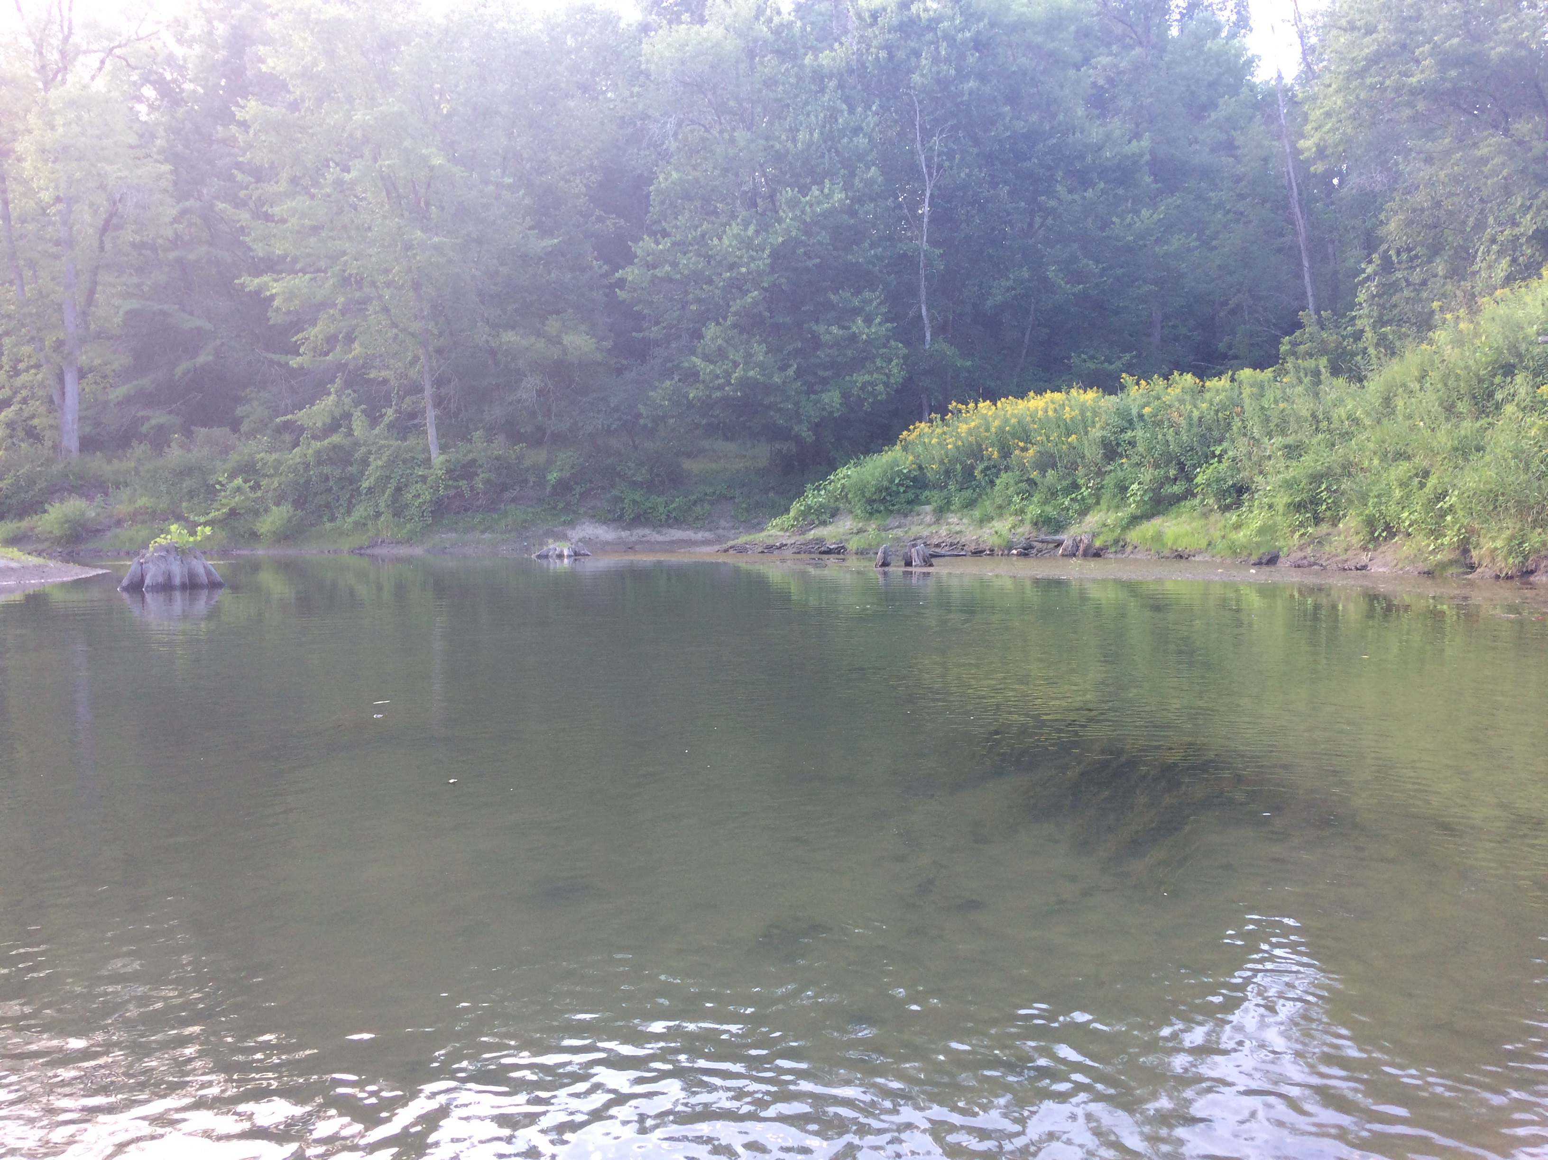
Notes:
Other hints from LIDAR

Slide 29
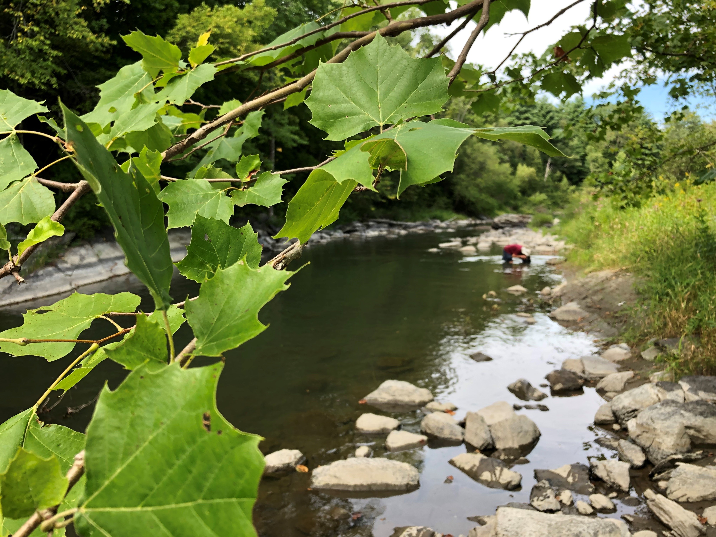
Dylan O’Leary (Americorps/TNC) Josh Duncan (Americorps/TNC) Lauren Sopher (LCC)
Notes:
Sobering bit of context with respect to systems oriented conservation efforts: mussels may not respond to the most commonly invoked levers of aquatic conservation practice.

